Slide 1

CS 484: Introduction to Machine Learning
Week 14
December 2, 2020

Slide 2
Week 14 Agenda: Gradient Boosting Learners
Motivation
Theory
Example

Slide 3
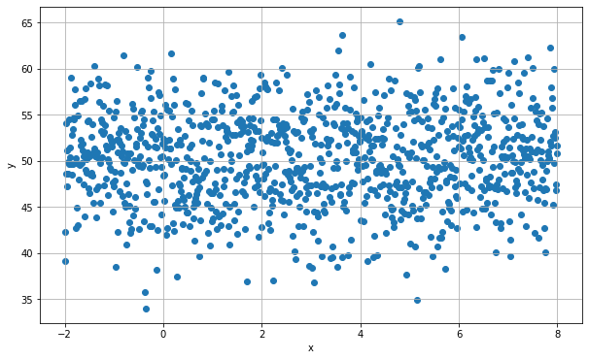

The Regression Line of $y$ on $x$
Variable | x | y
Mean | 3 | 50.2002
Standard Deviation | 2.8896 | 4.9739
Week 14 Gradient Boosting Regression Example.py

Slide 4

Did You Forget Something?
You asked Fred, a junior data scientist, to work on this problem, calculated a regression line, and saved the residuals on a file.
Since Fred did not think there is a relationship between Y and X, he built a regression line with only the Intercept term.
Although Fred saved the residuals and the predictor X on a file, Fred forgot to copy the original target variable Y to the file.

Slide 5
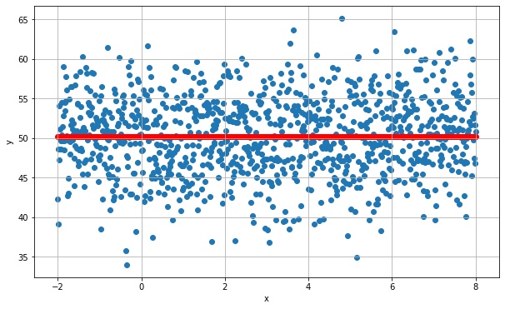
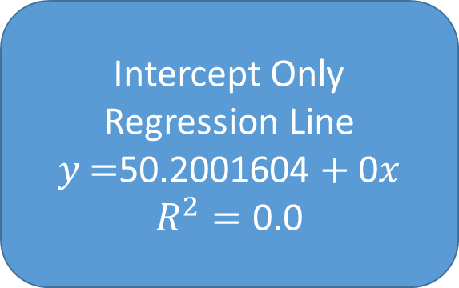
The Intercept-Only Regression
Intercept Only Regression Line
$$y\text{ =}\text{50.2001604}+\text{0}x$$
$$R^{2}=\text{0.0}$$

Slide 6
An Impossible Mission?
You do believe that there is a weak relationship between $x$ and $y$. You want to recover the original regression line.
You do believe that there is a weak relationship between 𝑥 and 𝑦. You want to recover the original regression line.
How can you build the original regression line without the original target variable $y$?
How can you build the original regression line without the original target variable 𝑦?
The solution is to build a regression line of the residuals on $x$.
The solution is to build a regression line of the residuals on 𝑥.

Slide 7
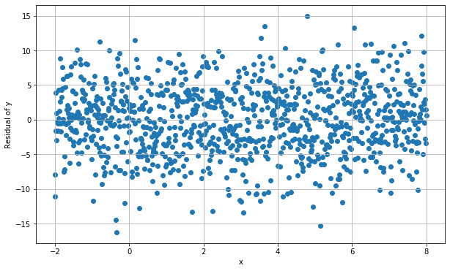
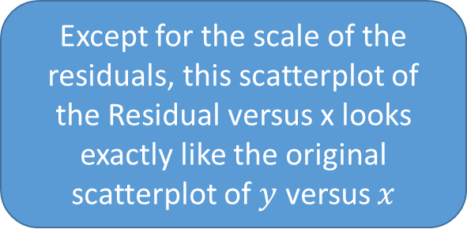
Residuals from the Intercept-Only Regression
Variable | x | Residual
Mean | 3 | 0.0
Standard Deviation | 2.8896 | 4.9739
Except for the scale of the residuals, this scatterplot of the Residual versus x looks exactly like the original scatterplot of $y$ versus $x$

Slide 8
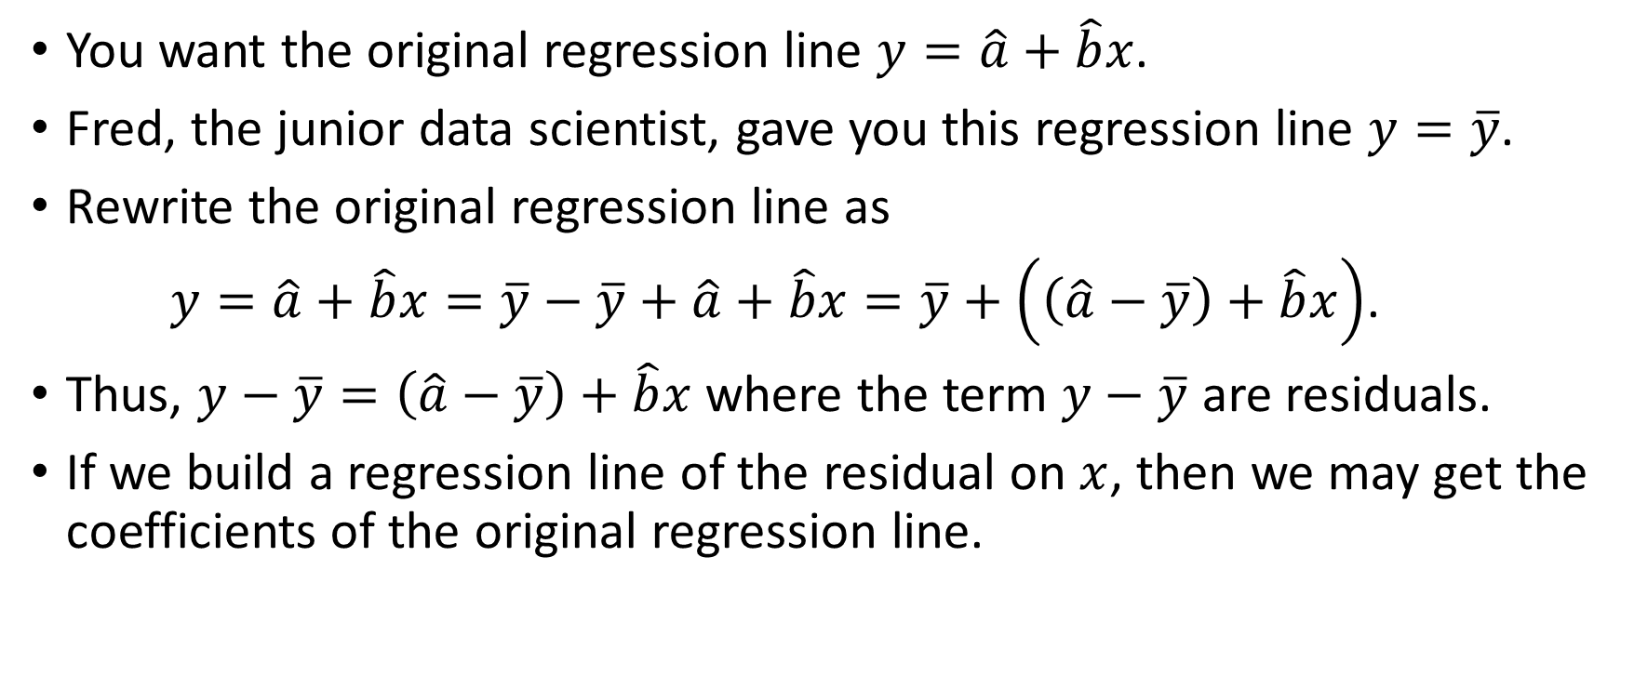
What is the Regression Line of y on x?
You want the original regression line $y=\hat{a}+\hat{b}x$.
Fred, the junior data scientist, gave you this regression line $y=\overline{y}$.
Rewrite the original regression line as
$y=\hat{a}+\hat{b}x=\overline{y}−\overline{y}+\hat{a}+\hat{b}x=\overline{y}+\left(\left(\hat{a}−\overline{y}\right)+\hat{b}x\right)$.
Thus, $y−\overline{y}=\left(\hat{a}−\overline{y}\right)+\hat{b}x$ where the term $y−\overline{y}$ are residuals.
If we build a regression line of the residual on $x$, then we may get the coefficients of the original regression line.

Slide 9
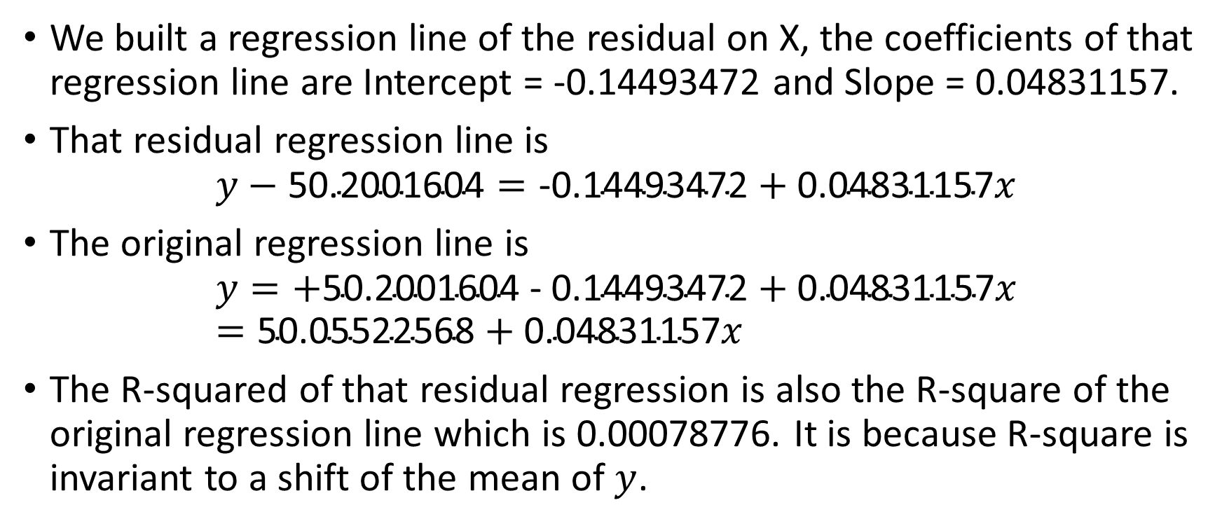
What is the Regression Line of y on x?
We built a regression line of the residual on X, the coefficients of that regression line are Intercept = -0.14493472 and Slope = 0.04831157.
That residual regression line is
$$y−\text{50.2001604}=\text{−0.14493472}+\text{0.04831157}x$$
The original regression line is
$$y=\text{+}\text{50.2001604}\text{ − }\text{0.14493472}+\text{0.04831157}x=\text{50.05522568}+\text{0.04831157}x$$
The R-squared of that residual regression is also the R-square of the original regression line which is 0.00078776. It is because R-square is invariant to a shift of the mean of $y$.

Slide 10
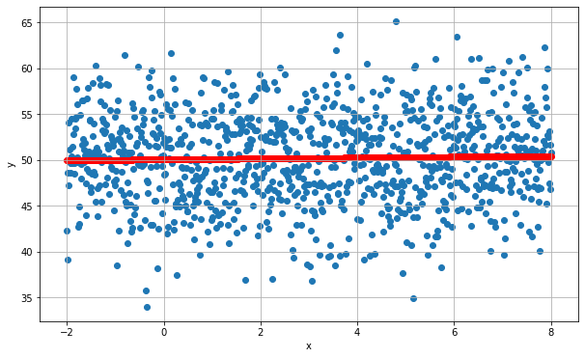
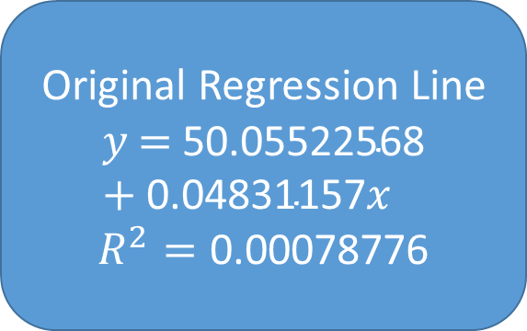
The Regression Line of y on x
Original Regression Line
$$y\text{ =} \text{50.05522568}+\text{0.04831157}x$$
$$R^{2}=\text{0.00078776}$$

Slide 11
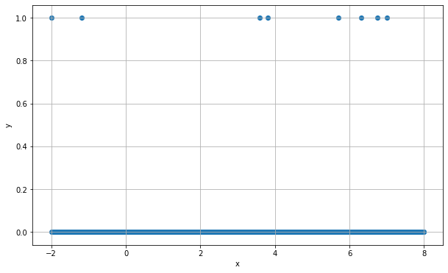
The Logistic Regression of y on x
Variable x | y = 0 | y = 1 | Total
Count | 993 | 8 | 1001
Mean | 2.99 | 3.75 | 3.0
Standard Deviation | 2.89 | 3.30 | 2.89
A Rare Event Problem Y = 1 in 0.8% Data
Week 14 Gradient Boosting Logistic Example.py

Slide 12
Rare Event Logistic Regression
Optimization terminated successfully.
Current function value: 0.046285
Iterations 9
MNLogit Regression Results
==============================================================================
Dep. Variable: y No. Observations: 1001
Model: MNLogit Df Residuals: 999
Method: MLE Df Model: 1
Date: Wed, 02 Dec 2020 Pseudo R-squ.: 0.005810
Time: 13:01:23 Log-Likelihood: -46.332
converged: True LL-Null: -46.602
Covariance Type: nonrobust LLR p-value: 0.4618
==============================================================================
y=1 coef std err z P>|z| [0.025 0.975]
------------------------------------------------------------------------------
const -5.1293 0.588 -8.720 0.000 -6.282 -3.976
x1 0.0913 0.125 0.728 0.466 -0.154 0.337
==============================================================================
Use the threshold 0.007992 for classifying y = 1
The accuracy is 0.541, fair result but we want to do better
What can we do if we hesitate to include higher power terms, e.g., x²?

Slide 13
What Can the Residuals Tell us?
Consider the error definition in calculating the Root Average Square Error metric
Suppose ${\hat{p}}_{1i}$ is the predicted probability of $y=1$ for the $i^{th}$ observation
Suppose 𝑝 ̂_1𝑖 is the predicted probability of 𝑦=1 for the 𝑖^th observation
Residual is $r_{i}=1−{\hat{p}}_{1i}$ if $y_{1i}=1$ and $r_{i}=0−{\hat{p}}_{1i}$ if $y_{1i}=0$
Residual is 𝑟_𝑖=1−𝑝 ̂_1𝑖 if 𝑦_1𝑖=1 and 𝑟_𝑖=0−𝑝 ̂_1𝑖 if 𝑦_1𝑖=0

Slide 14
What Can We Do With the Residuals?
Cannot
Use Residual as Target Variable
In logistic regression because Residual is not a categorical variable
May Be
Use Residual as Target Variable
In regression tree because Residual is an interval variable, and the predicted value will always within the range of the Residual
In linear regression because Residual is bounded to [-1, 1]

Slide 15
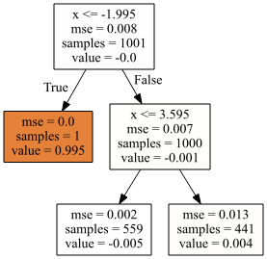
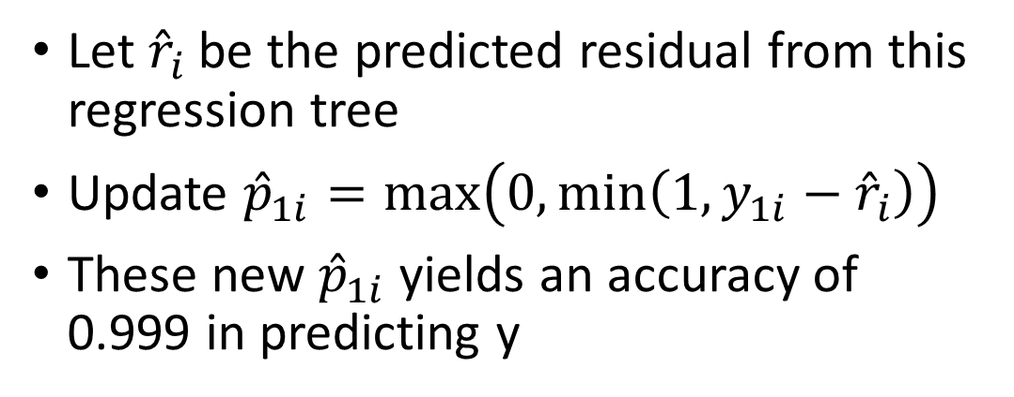
Regression Tree on Residuals
residP = y - yPredProb[:,1] #
_objTree = tree.DecisionTreeRegressor(criterion = 'mse', max_depth = 2, random_state = 60616)
thisTree = _objTree.fit(x, residP)
residPred = thisTree.predict(x)as
Let ${\hat{r}}_{i}$ be the predicted residual from this regression tree
Update ${\hat{p}}_{1i}=max\left(0,min\left(1,y_{1i}−{\hat{r}}_{i}\right)\right)$
These new ${\hat{p}}_{1i}$yields an accuracy of 0.999 in predicting y

Slide 16
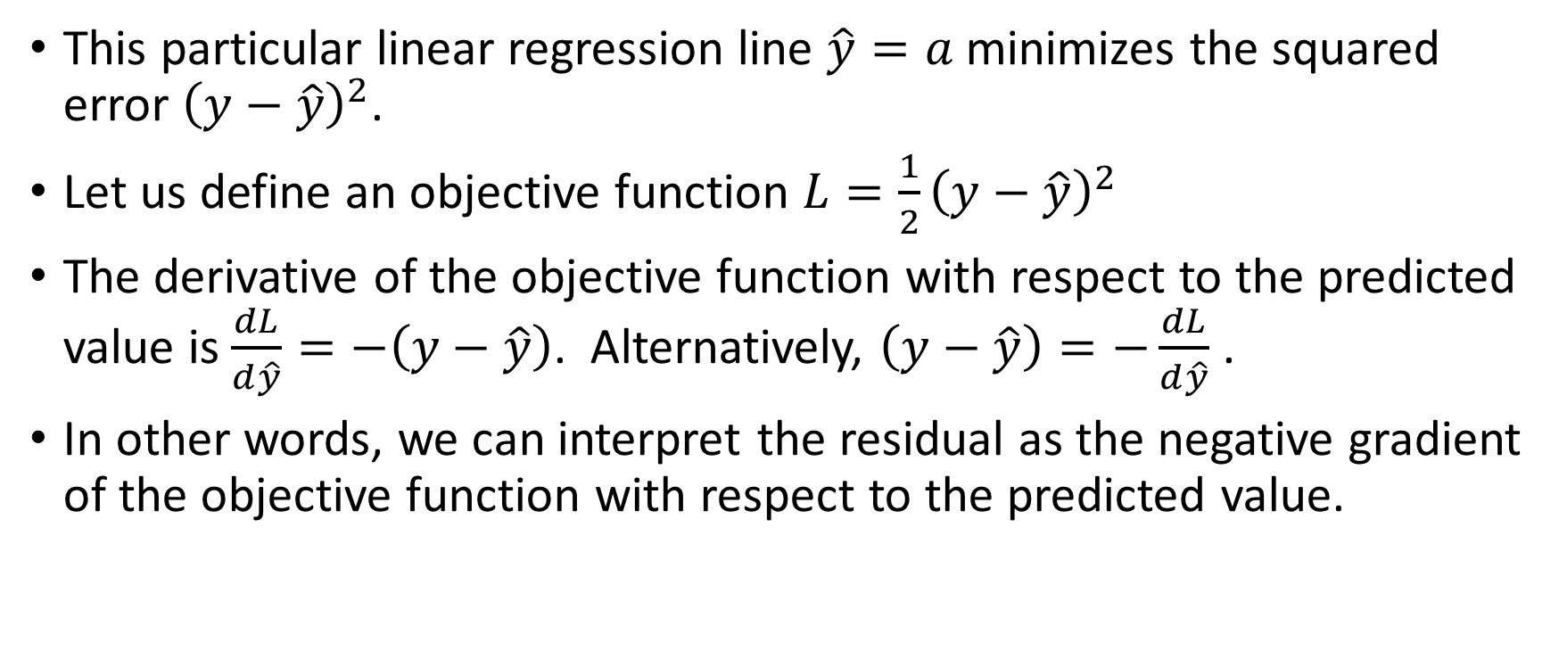
What are the Linear Regression Residuals?
This particular linear regression line $\hat{y}=a$ minimizes the squared error ${\left(y−\hat{y}\right)}^{2}$.
Let us define an objective function ${L=\frac{1}{2}\left(y−\hat{y}\right)}^{2}$
The derivative of the objective function with respect to the predicted value is $\frac{dL}{d\hat{y}}=−\left(y−\hat{y}\right)$. Alternatively, $\left(y−\hat{y}\right)=−\frac{dL}{d\hat{y}}$ .
In other words, we can interpret the residual as the negative gradient of the objective function with respect to the predicted value.

Slide 17
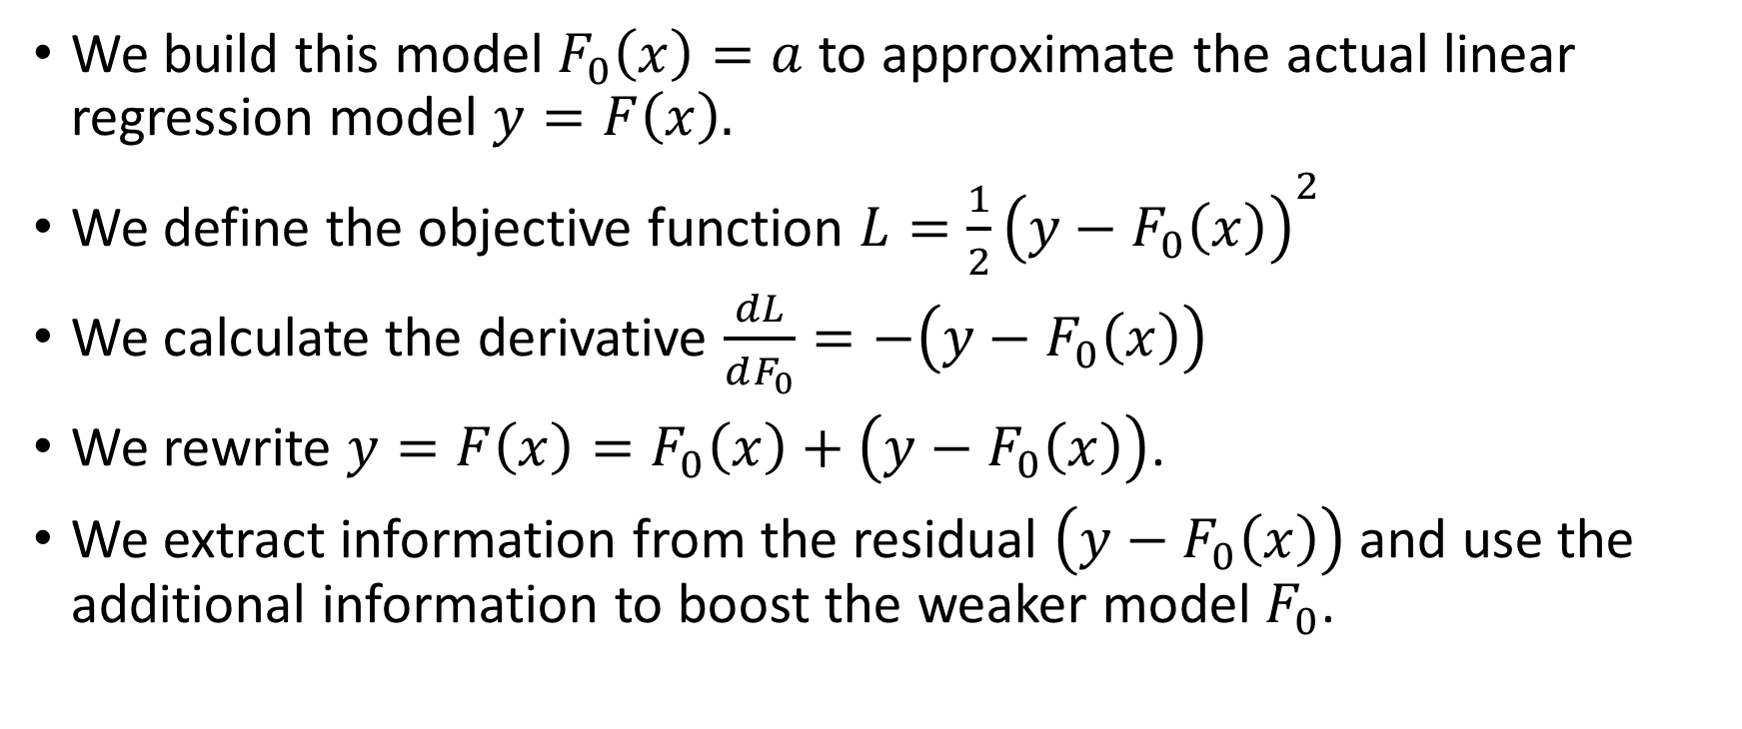
The Motivation of Gradient Boosting
We build this model $F_{0}\left(x\right)=a$ to approximate the actual linear regression model $y=F\left(x\right).$
We define the objective function ${L=\frac{1}{2}\left(y−F_{0}\left(x\right)\right)}^{2}$
We calculate the derivative $\frac{dL}{dF_{0}}=−\left(y−F_{0}\left(x\right)\right)$
We rewrite $y=F\left(x\right)=F_{0}\left(x\right)+\left(y−F_{0}\left(x\right)\right)$.
We extract information from the residual $\left(y−F_{0}\left(x\right)\right)$ and use the additional information to boost the weaker model $F_{0}$.

Slide 18
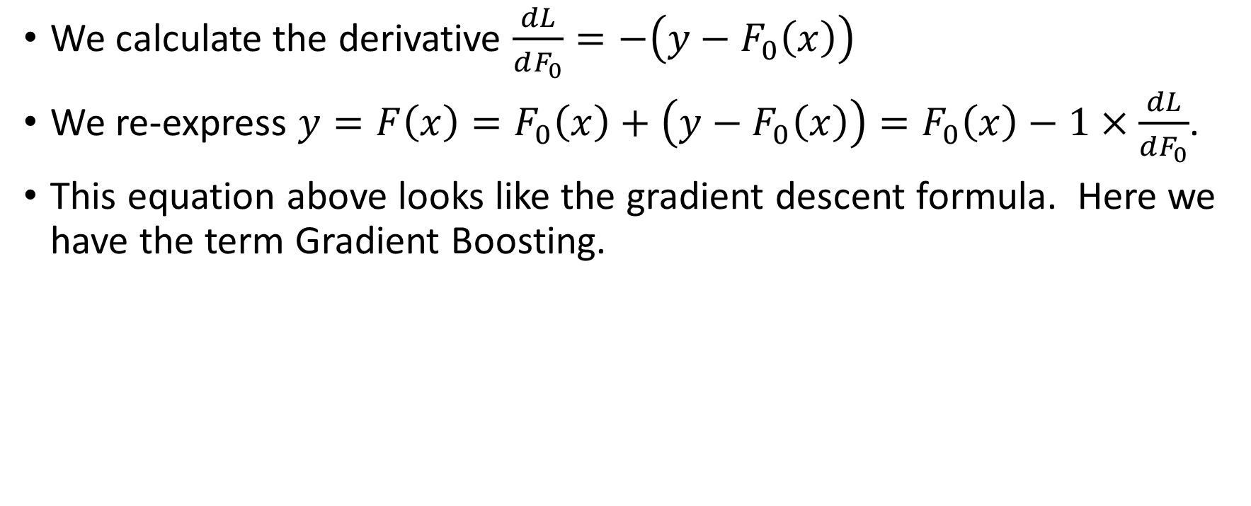
The Motivation of Gradient Boosting
We calculate the derivative $\frac{dL}{dF_{0}}=−\left(y−F_{0}\left(x\right)\right)$
We re-express $y=F\left(x\right)=F_{0}\left(x\right)+\left(y−F_{0}\left(x\right)\right)=F_{0}\left(x\right)−1×\frac{dL}{dF_{0}}$.
This equation above looks like the gradient descent formula. Here we have the term Gradient Boosting.

Slide 19
History of Boosting Algorithms
AdaBoost. Yoav Freund and Robert E. Schapire (1997). A decision-theoretic generalization of on-line learning and an application to boosting. Journal of Computer and System Sciences, 55(1): 119-139.
A preliminary version appeared in the Proceedings of the Second European Conference on Computational Learning Theory, 1995. pages 23-37
Yoav Freund (1961 -), Professor of Computer Science and Engineering, University of California San Diego.
Robert E. Schapire (1963 - ), Principal Researcher, Microsoft Research in New York City.
Formulate AdaBoost as gradient descent with a special loss function. Leo Breiman (1998). Arcing Classifiers. The Annals of Statistics, 26(3): 801-849.
Leo Breiman (1928 – 2005), Professor Emeritus of Statistics at the University of California, Berkeley.

Slide 20
History of Boosting Algorithms
Generalize AdaBoost to Gradient Boosting with a general loss function. Jerome H. Friedman (2001). Greedy Function Approximation: A Gradient Boosting Machine. The Annals of Statistics, 29(5): 1189-1232.
Jerome H. Friedman (1939 - ), Professor Emeritus of Statistics, Stanford University.

Slide 21
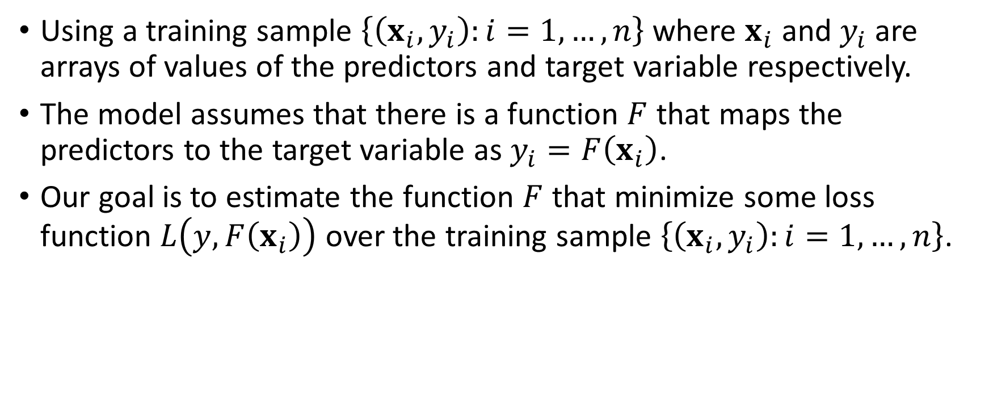
Gradient Boosting (Friedman, 2001)
Using a training sample $\left\{\left(x_{i},y_{i}\right):i=1,…,n\right\}$ where $x_{i}$ and $y_{i}$are arrays of values of the predictors and target variable respectively.
The model assumes that there is a function $F$ that maps the predictors to the target variable as $y_{i}=F\left(x_{i}\right)$.
Our goal is to estimate the function $F$ that minimize some loss function $L\left(y,F\left(x_{i}\right)\right)$ over the training sample $\left\{\left(x_{i},y_{i}\right):i=1,…,n\right\}$.

Slide 22
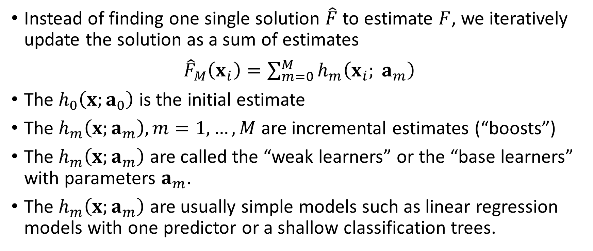
Gradient Boosting (Friedman, 2001)
Instead of finding one single solution $\hat{F}$ to estimate $F$, we iteratively update the solution as a sum of estimates
${\hat{F}}_{M}\left(x_{i}\right)=\sum_{m=0}^{M}{h_{m}\left(x_{i}; a_{m}\right)}$
The $h_{0}\left(x;a_{0}\right)$ is the initial estimate
The $h_{m}\left(x;a_{m}\right),m=1,…,M$ are incremental estimates (“boosts”)
The $h_{m}\left(x;a_{m}\right)$ are called the “weak learners” or the “base learners” with parameters $a_{m}$.
The $h_{m}\left(x;a_{m}\right)$ are usually simple models such as linear regression models with one predictor or a shallow classification trees.

Slide 23
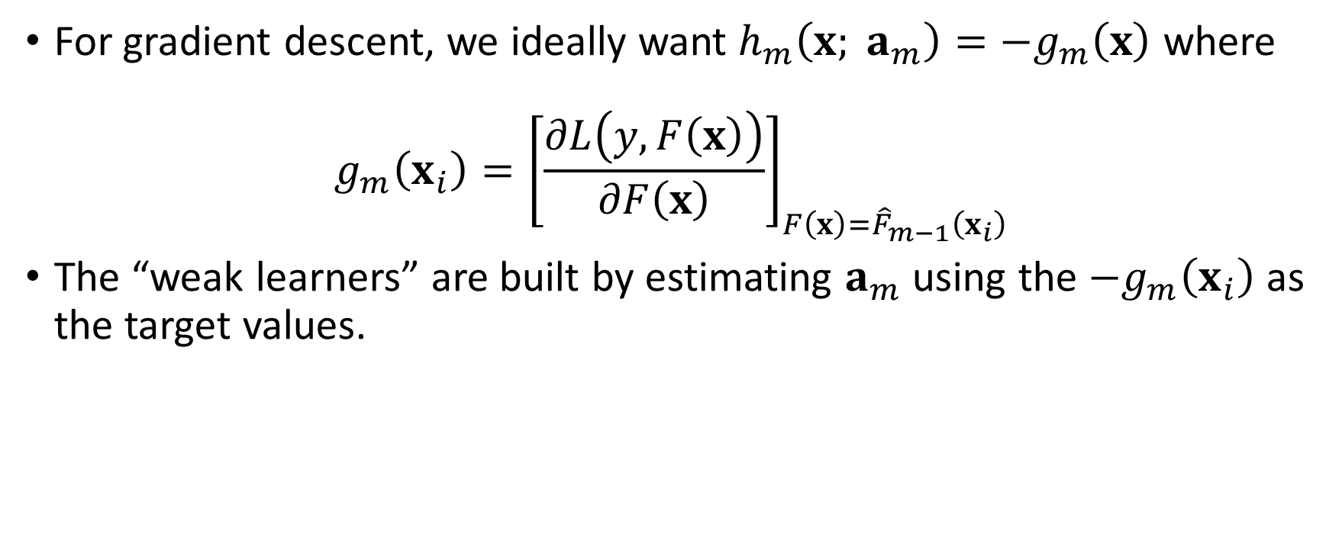
Gradient Boosting (Friedman, 2001)
For gradient descent, we ideally want $h_{m}\left(x; a_{m}\right)=−g_{m}\left(x\right)$ where
$$g_{m}\left(x_{i}\right)={\left[\frac{∂L\left(y,F\left(x\right)\right)}{∂F\left(x\right)}\right]}_{F\left(x\right)={\hat{F}}_{m−1}\left(x_{i}\right)}$$
The “weak learners” are built by estimating $a_{m}$ using the ${−g}_{m}\left(x_{i}\right)$ as the target values.

Slide 24
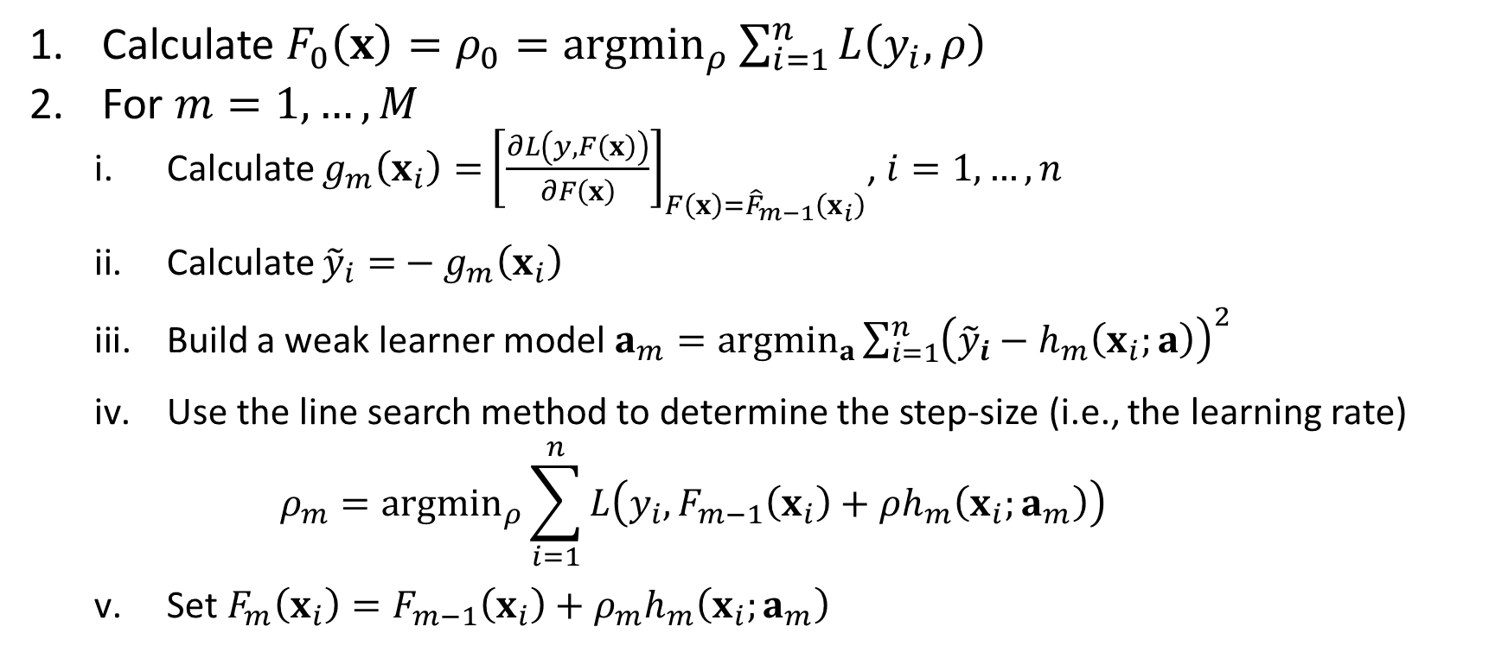
Gradient Boosting Algorithm
Calculate $F_{0}\left(x\right)=ρ_{0}={argmin}_{ρ}\sum_{i=1}^{n}{L\left(y_{i},ρ\right)}$
For $m=1,…,M$
Calculate $g_{m}\left(x_{i}\right)=$ ${\left[\frac{∂L\left(y,F\left(x\right)\right)}{∂F\left(x\right)}\right]}_{F\left(x\right)={\hat{F}}_{m−1}\left(x_{i}\right)}$, $i=1,…,n$
Calculate ${\tilde{y}}_{i}=$ ${− g}_{m}\left(x_{i}\right)$
Build a weak learner model $a_{m}={argmin}_{a}\sum_{i=1}^{n}{{\left({\tilde{y}}_{i}−h_{m}\left(x_{i};a\right)\right)}^{2}}$
Use the line search method to determine the step-size (i.e., the learning rate) $ρ_{m}={argmin}_{ρ}\sum_{i=1}^{n}{L\left(y_{i}, F_{m−1}\left(x_{i}\right)+ρh_{m}\left(x_{i};a_{m}\right)\right)}$
Set $F_{m}\left(x_{i}\right)=F_{m−1}\left(x_{i}\right)+ρ_{m}h_{m}\left(x_{i};a_{m}\right)$

Slide 25
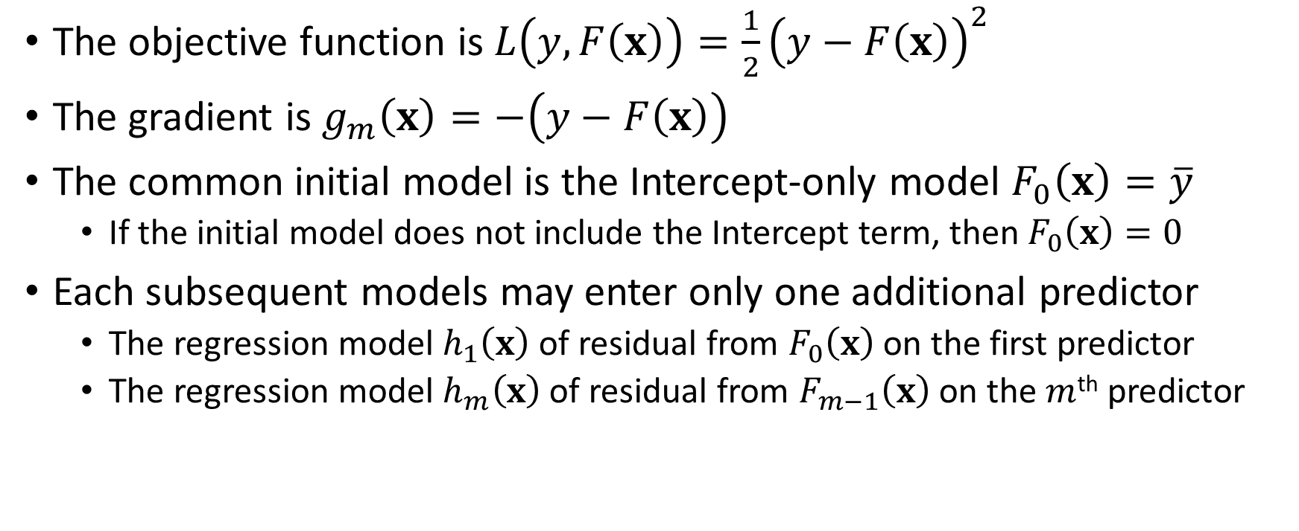
Least Squares Regression
The objective function is $L\left(y,F\left(x\right)\right)=\frac{1}{2}{\left(y−F\left(x\right)\right)}^{2}$
The gradient is $g_{m}\left(x\right)=−\left(y−F\left(x\right)\right)$
The common initial model is the Intercept-only model $F_{0}\left(x\right)=\overline{y}$
If the initial model does not include the Intercept term, then $F_{0}\left(x\right)=0$
Each subsequent models may enter only one additional predictor
The regression model $h_{1}\left(x\right)$of residual from $F_{0}\left(x\right)$ on the first predictor
The regression model $h_{m}\left(x\right)$of residual from $F_{m−1}\left(x\right)$ on the $m$^{th} predictor

Slide 26
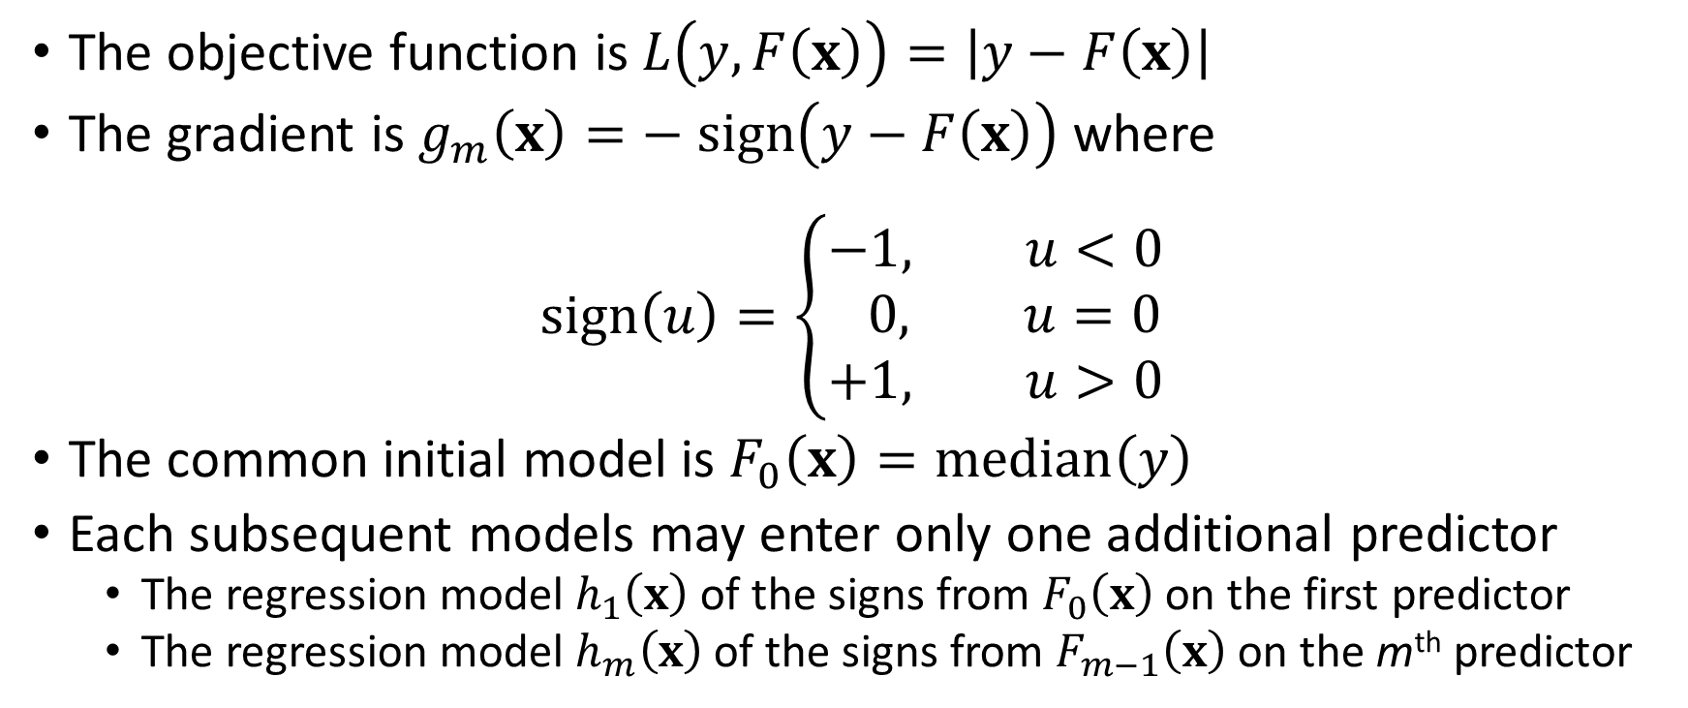
Least Absolute Deviation (LAD) Regression
The objective function is $L\left(y,F\left(x\right)\right)=\left|y−F\left(x\right)\right|$
The gradient is $g_{m}\left(x\right)=− sign\left(y−F\left(x\right)\right)$ where
$$sign\left(u\right)=\left\{\begin{aligned}−&1, u<0 \\ 0, u=0 \\ +1, u>0\end{aligned}\right.$$
The common initial model is $F_{0}\left(x\right)=median\left(y\right)$
Each subsequent models may enter only one additional predictor
The regression model $h_{1}\left(x\right)$of the signs from $F_{0}\left(x\right)$ on the first predictor
The regression model $h_{m}\left(x\right)$of the signs from $F_{m−1}\left(x\right)$ on the m^{th} predictor

Slide 27
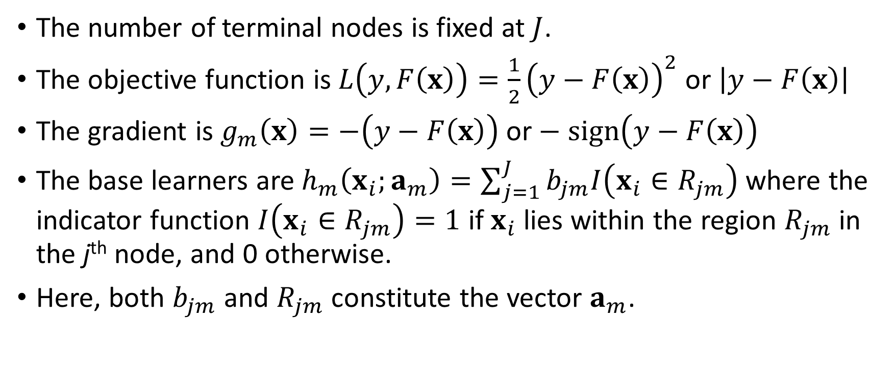
Regression Tree
The number of terminal nodes is fixed at $J$.
The objective function is $L\left(y,F\left(x\right)\right)=\frac{1}{2}{\left(y−F\left(x\right)\right)}^{2}$ or $\left|y−F\left(x\right)\right|$
The gradient is $g_{m}\left(x\right)=−\left(y−F\left(x\right)\right)$or $− sign\left(y−F\left(x\right)\right)$
The base learners are $h_{m}\left(x_{i};a_{m}\right)=\sum_{j=1}^{J}{b_{jm}I\left(x_{i}∈R_{jm}\right)}$ where the indicator function $I\left(x_{i}∈R_{jm}\right)=1$ if $x_{i}$ lies within the region $R_{jm}$ in the j^{th} node, and 0 otherwise.
Here, both $b_{jm}$ and $R_{jm}$ constitute the vector $a_{m}$.

Slide 28
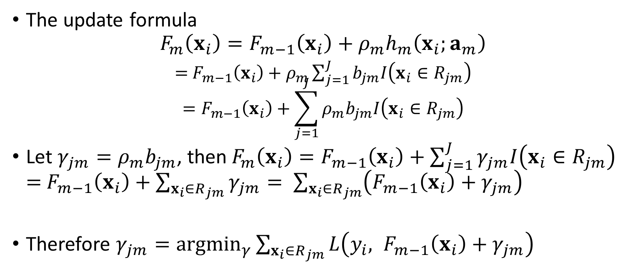
Regression Tree
The update formula
$$F_{m}\left(x_{i}\right)=F_{m−1}\left(x_{i}\right)+ρ_{m}h_{m}\left(x_{i};a_{m}\right)$$
$=$ $F_{m−1}\left(x_{i}\right)+ρ_{m}\sum_{j=1}^{J}{b_{jm}I\left(x_{i}∈R_{jm}\right)}$ $$=F_{m−1}\left(x_{i}\right)+\sum_{j=1}^{J}{ρ_{m}b_{jm}I\left(x_{i}∈R_{jm}\right)}$$
Let $γ_{jm}=ρ_{m}b_{jm}$, then$F_{m}\left(x_{i}\right)=F_{m−1}\left(x_{i}\right)+\sum_{j=1}^{J}{γ_{jm}I\left(x_{i}∈R_{jm}\right)}$ $=$ $F_{m−1}\left(x_{i}\right)+\sum_{x_{i}∈R_{jm}}{γ_{jm}}= \sum_{x_{i}∈R_{jm}}{\left(F_{m−1}\left(x_{i}\right)+γ_{jm}\right)}$
Therefore $γ_{jm}={argmin}_{γ}\sum_{x_{i}∈R_{jm}}{L\left({y_{i}, F}_{m−1}\left(x_{i}\right)+γ_{jm}\right)}$

Slide 29
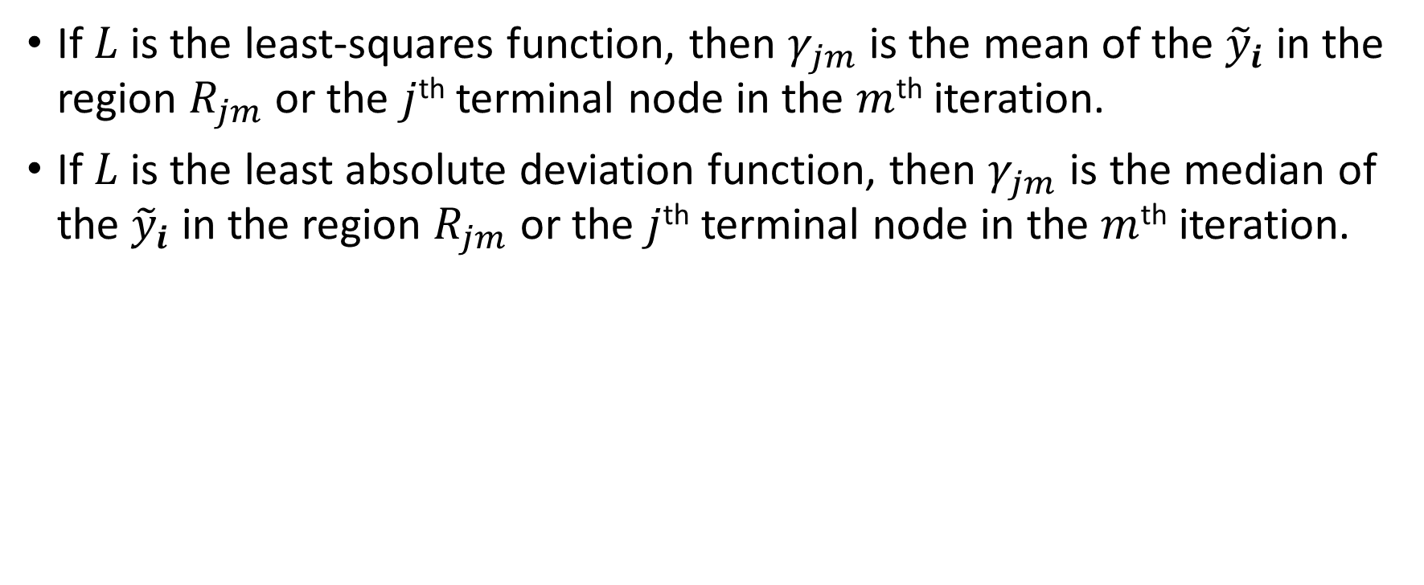
Regression Tree
If $L$ is the least-squares function, then $γ_{jm}$ is the mean of the ${\tilde{y}}_{i}$ in the region $R_{jm}$ or the $j$^{th} terminal node in the $m$^{th} iteration.
If $L$ is the least absolute deviation function, then $γ_{jm}$ is the median of the ${\tilde{y}}_{i}$ in the region $R_{jm}$ or the $j$^{th} terminal node in the $m$^{th} iteration.

Slide 30
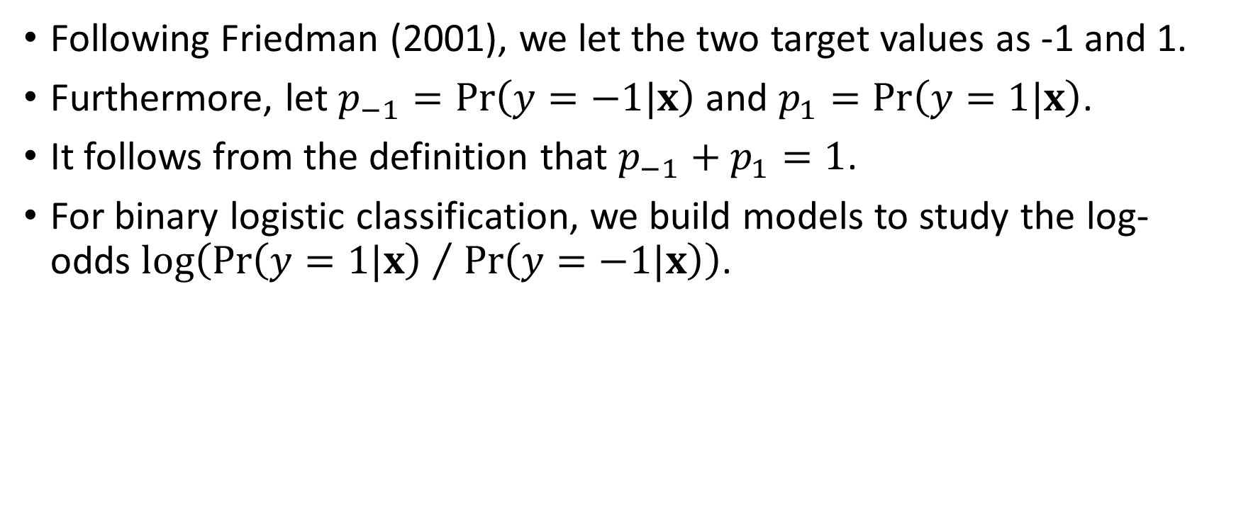
Binary Logistic Classification
Following Friedman (2001), we let the two target values as -1 and 1.
Furthermore, let $p_{−1}=Pr\left(y=−1|x\right)$ and $p_{1}=Pr\left(y=1|x\right)$.
It follows from the definition that $p_{−1}+p_{1}=1$.
For binary logistic classification, we build models to study the log-odds $log\left({Pr\left(y=1|x\right) }/{ Pr\left(y=−1|x\right)}\right)$.

Slide 31
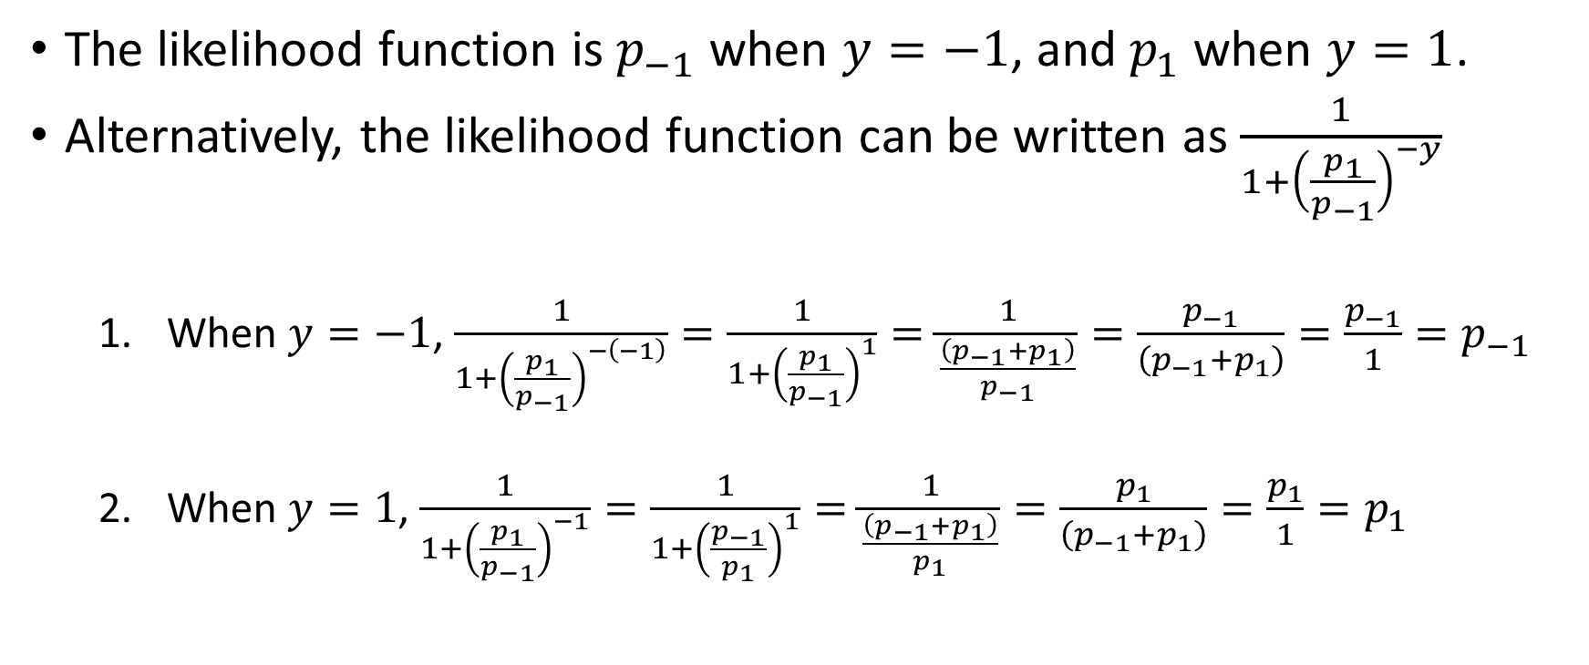
Binary Logistic Classification
The likelihood function is $p_{−1}$ when $y=−1$, and $p_{1}$ when $y=1$.
Alternatively, the likelihood function can be written as $\frac{1}{1+{\left(\frac{p_{1}}{p_{−1}}\right)}^{−y}}$
When $y=−1$, $\frac{1}{1+{\left(\frac{p_{1}}{p_{−1}}\right)}^{−\left(−1\right)}}=\frac{1}{1+{\left(\frac{p_{1}}{p_{−1}}\right)}^{1}}=\frac{1}{\frac{\left(p_{−1}+p_{1}\right)}{p_{−1}}}=\frac{p_{−1}}{\left(p_{−1}+p_{1}\right)}=\frac{p_{−1}}{1}=p_{−1}$
When $y=1$, $\frac{1}{1+{\left(\frac{p_{1}}{p_{−1}}\right)}^{−1}}=\frac{1}{1+{\left(\frac{p_{−1}}{p_{1}}\right)}^{1}}=\frac{1}{\frac{\left(p_{−1}+p_{1}\right)}{p_{1}}}=\frac{p_{1}}{\left(p_{−1}+p_{1}\right)}=\frac{p_{1}}{1}=p_{1}$

Slide 32
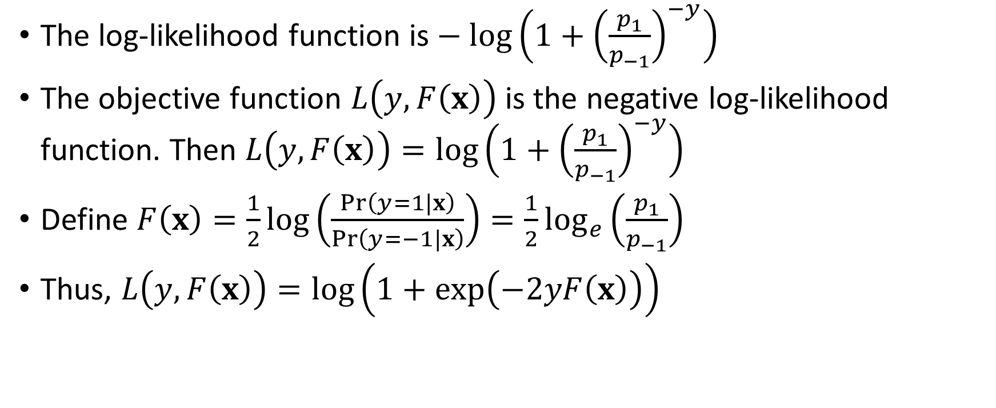
Binary Logistic Classification
The log-likelihood function is $− log\left(1+{\left(\frac{p_{1}}{p_{−1}}\right)}^{−y}\right)$
The objective function $L\left(y,F\left(x\right)\right)$ is the negative log-likelihood function. Then $L\left(y,F\left(x\right)\right)=log\left(1+{\left(\frac{p_{1}}{p_{−1}}\right)}^{−y}\right)$
Define $F\left(x\right)=\frac{1}{2}log\left(\frac{Pr\left(y=1|x\right)}{Pr\left(y=−1|x\right)}\right)=\frac{1}{2}\log_{e}\left(\frac{p_{1}}{p_{−1}}\right)$
Thus, $L\left(y,F\left(x\right)\right)=log\left(1+exp\left(−2yF\left(x\right)\right)\right)$

Slide 33
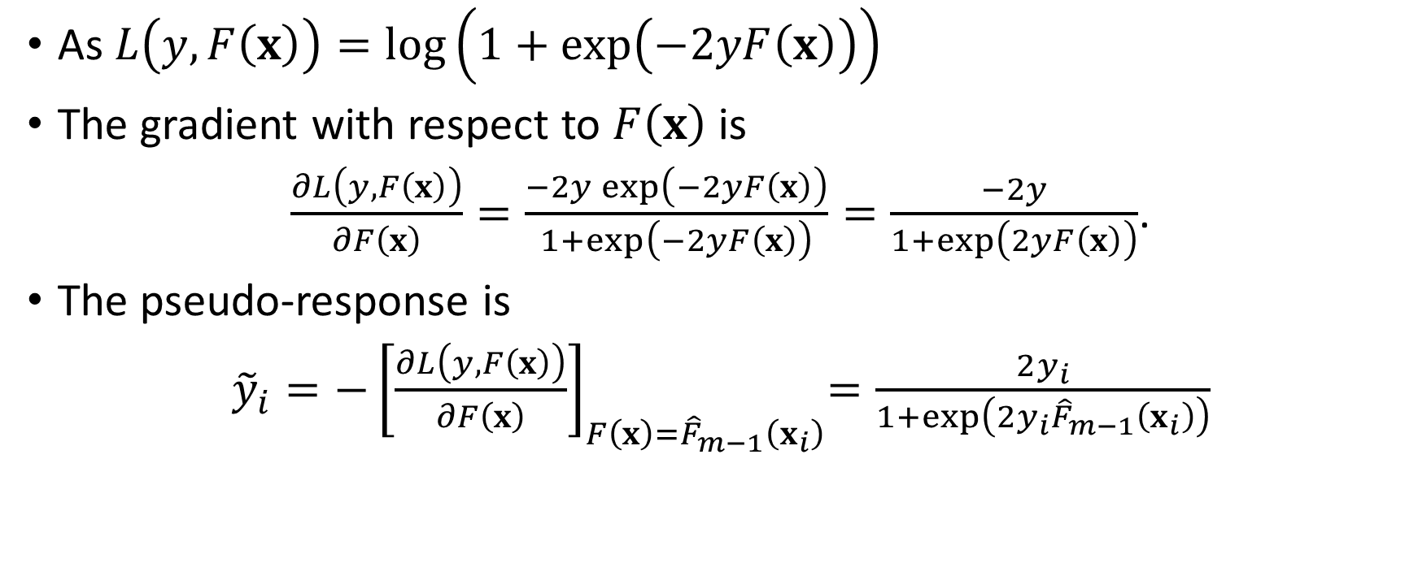
Binary Logistic Classification
As $L\left(y,F\left(x\right)\right)=log\left(1+exp\left(−2yF\left(x\right)\right)\right)$
The gradient with respect to $F\left(x\right)$ is
$\frac{∂L\left(y,F\left(x\right)\right)}{∂F\left(x\right)}=\frac{−2y exp\left(−2yF\left(x\right)\right)}{1+exp\left(−2yF\left(x\right)\right)}=\frac{−2y}{1+exp\left(2yF\left(x\right)\right)}$.
The pseudo-response is
${\tilde{y}}_{i}={−\left[\frac{∂L\left(y,F\left(x\right)\right)}{∂F\left(x\right)}\right]}_{F\left(x\right)={\hat{F}}_{m−1}\left(x_{i}\right)}=\frac{2y_{i}}{1+exp\left(2y_{i}{\hat{F}}_{m−1}\left(x_{i}\right)\right)}$

Slide 34
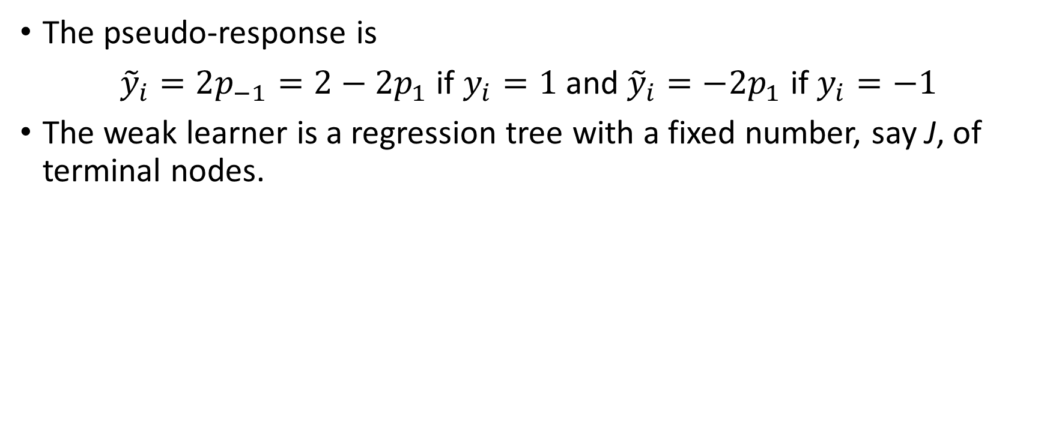
Binary Logistic Classification
The pseudo-response is
${\tilde{y}}_{i}=2p_{−1}=2−2p_{1}$ if $y_{i}=1$ and ${\tilde{y}}_{i}=−2p_{1}$ if $y_{i}=−1$
The weak learner is a regression tree with a fixed number, say J, of terminal nodes.

Slide 35
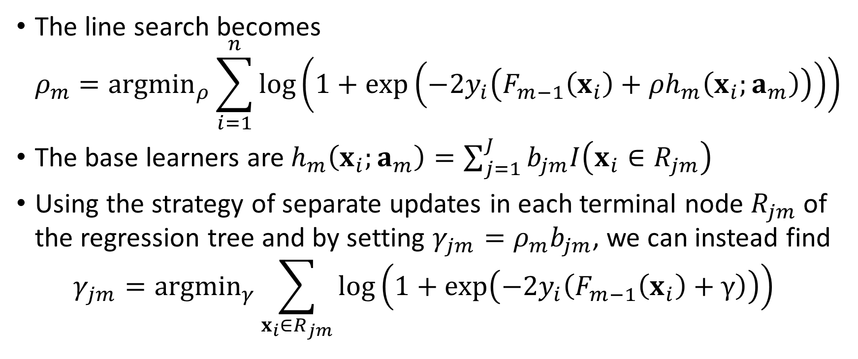
Binary Logistic Classification
The line search becomes $ρ_{m}={argmin}_{ρ}\sum_{i=1}^{n}{log\left(1+exp\left(−2y_{i}\left(F_{m−1}\left(x_{i}\right)+ρh_{m}\left(x_{i};a_{m}\right)\right)\right)\right)}$
The base learners are $h_{m}\left(x_{i};a_{m}\right)=\sum_{j=1}^{J}{b_{jm}I\left(x_{i}∈R_{jm}\right)}$
Using the strategy of separate updates in each terminal node $R_{jm}$ of the regression tree and by setting $γ_{jm}=ρ_{m}b_{jm}$, we can instead find $γ_{jm}={argmin}_{γ}\sum_{x_{i}∈R_{jm}}{log\left(1+exp\left(−2y_{i}\left(F_{m−1}\left(x_{i}\right)+γ\right)\right)\right)}$

Slide 36
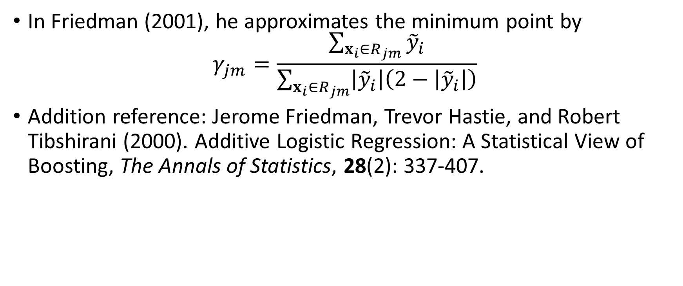
Binary Logistic Classification
In Friedman (2001), he approximates the minimum point by $γ_{jm}=\frac{\sum_{x_{i}∈R_{jm}}{{\tilde{y}}_{i}}}{\sum_{x_{i}∈R_{jm}}{\left|{\tilde{y}}_{i}\right|\left(2−\left|{\tilde{y}}_{i}\right|\right)}}$
Addition reference: Jerome Friedman, Trevor Hastie, and Robert Tibshirani (2000). Additive Logistic Regression: A Statistical View of Boosting, The Annals of Statistics, 28(2): 337-407.

Slide 37
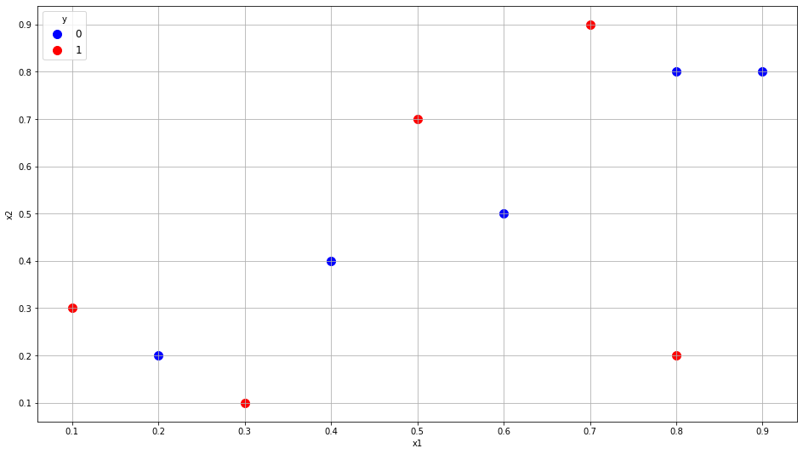
Ten Observations Toy Example
Ten observations
Two interval predictors X1 and X2
Binary target Y (1 = Event, 0 = Non-Event)
Index | x1 | x2 | y
0 | 0.1 | 0.3 | 1
1 | 0.2 | 0.2 | 0
2 | 0.3 | 0.1 | 1
3 | 0.4 | 0.4 | 0
4 | 0.5 | 0.7 | 1
5 | 0.6 | 0.5 | 0
6 | 0.7 | 0.9 | 1
7 | 0.8 | 0.8 | 0
8 | 0.8 | 0.2 | 1
9 | 0.9 | 0.8 | 0
Week 14 Toy Gradient Boost Example.py

Slide 38
Toy Example: Data
import matplotlib.pyplot as plt
import numpy
import sklearn.metrics as metrics
import sklearn.tree as tree
import statsmodels.api as stats
x_train = numpy.array([[0.1, 0.3],
[0.2, 0.2],
[0.3, 0.1],
[0.4, 0.4],
[0.5, 0.7],
[0.6, 0.5],
[0.7, 0.9],
[0.8, 0.8],
[0.8, 0.2],
[0.9, 0.8]], dtype = float)
y_train = numpy.array([1, 0, 1, 0, 1, 0, 1, 0, 1, 0], dtype = float)
Week 14 Toy Gradient Boost Example.py

Slide 39
Toy Example: Train a Logistic Regression
# Train a logistic regression model
X = stats.add_constant(x_train, prepend=True)
logit = stats.MNLogit(y_train, X)
thisFit = logit.fit(method = 'bfgs', maxiter = 100, tol = 1e-8)
thisParameter = thisFit.params
yPredProb = thisFit.predict(X)
print(thisFit.summary())
threshPredProb = numpy.mean(y_train)
yPredClass = numpy.where(yPredProb[:,1] >= threshPredProb, 1, 0)
y_accuracy = metrics.accuracy_score(y_train, yPredClass)
print("Accuracy Score = ", y_accuracy)
Week 14 Toy Gradient Boost Example.py

Slide 40
Toy Example: Logistic Regression Result
Optimization terminated successfully.
Current function value: 0.671726
Iterations: 20
Function evaluations: 21
Gradient evaluations: 21
MNLogit Regression Results
==============================================================================
Dep. Variable: y No. Observations: 10
Model: MNLogit Df Residuals: 7
Method: MLE Df Model: 2
Date: Wed, 02 Dec 2020 Pseudo R-squ.: 0.03090
Time: 15:18:56 Log-Likelihood: -6.7173
converged: True LL-Null: -6.9315
Covariance Type: nonrobust LLR p-value: 0.8072
==============================================================================
y=1 coef std err z P>|z| [0.025 0.975]
------------------------------------------------------------------------------
const 0.8906 1.534 0.581 0.562 -2.116 3.897
x1 -1.0146 3.208 -0.316 0.752 -7.303 5.273
x2 -0.7193 3.004 -0.239 0.811 -6.607 5.168
==============================================================================
Accuracy Score = 0.5

Slide 41
Toy Example: Ready for Gradient Boosting
# Iteration 0
# Preparation for Gradient Boosting Algorithm
currentP = yPredProb[:,1]
objFunc = numpy.sum(numpy.log(numpy.where(y_train == 1, currentP, 1.0-currentP)))
print('Objective Function = ', objFunc)
print('Predicted Event Probability:\n', yPredProb[:,1])
Objective Function = -6.717263804639264
Predicted Event Probability:
[0.63954173 0.63270562 0.62581572 0.54910672 0.4699903 0.48056243 0.38533537
0.37836428 0.48377325 0.35481085]
Week 14 Toy Gradient Boost Example.py

Slide 42
Toy Example: Gradient Boosting Iterations
for iter in range(10):
print('Iteration = ', iter+1)
pseudoY = 2.0 * numpy.where(y_train == 1, 1.0-currentP, -currentP)
# Set maximum number of leaves to 4
regTree = tree.DecisionTreeRegressor(criterion='mse', max_leaf_nodes=4, random_state=60616)
treeFit = regTree.fit(x_train, pseudoY)
treePredProb = regTree.predict(x_train)
# Find a feasible step using a grid search 1.0, 0.9, 0.8, etc.
qGoodStep = 0
for step in numpy.arange(1.0,0.0,-0.1):
nextP = currentP + step * treePredProb
nextP = numpy.where(nextP >= 1.0, 1.0, nextP)
nextP = numpy.where(nextP <= 0.0, 0.0, nextP)
objFunc1 = numpy.sum(numpy.log(numpy.where(y_train == 1, nextP, 1.0-nextP)))
# print(step, objFunc1)
if (not numpy.isnan(objFunc1)):
if (objFunc1 > objFunc):
qGoodStep = 1
step1 = step
objFunc = objFunc1
# If a feasible step is found
if (qGoodStep == 1):
nextP = currentP + step1 * treePredProb
nextP = numpy.where(nextP >= 1.0, 1.0, nextP)
nextP = numpy.where(nextP <= 0.0, 0.0, nextP)
objFunc = numpy.sum(numpy.log(numpy.where(y_train == 1, nextP, 1.0-nextP)))
print('Step = ', step1)
print('Objective Function = ', objFunc)
currentP = nextP
print('Predicted Event Probability:\n', currentP)
yPredClass = numpy.where(currentP >= threshPredProb, 1, 0)
y_accuracy = metrics.accuracy_score(y_train, yPredClass)
print("Accuracy Score = ", y_accuracy)

Slide 43
Toy Example: Iteration Summary
Iteration | Step Size | Objective Function | Accuracy Score
0 | Not Applicable | -6.71726380 | 0.5
1 | 0.6 | -3.76665963 | 0.8
2 | 0.6 | -0.90396515 | 1.0
3 | 1.0 | -0.12062008 | 1.0
4 | 1.0 | -0.02608757 | 1.0
5 | 0.8 | -0.01300144 | 1.0
6 | 1.0 | 0.0 | 1.0
Note: Iteration stops at the sixth iteration because the objective function cannot be further improved.

Slide 44
Toy Example: Predicted Event Probabilities
Iteration | Observation Index
 | 0 | 1 | 2 | 3 | 4 | 5 | 6 | 7 | 8 | 9
Y_train | 1 | 0 | 1 | 0 | 1 | 0 | 1 | 0 | 1 | 0
0 | 0.63954173 | 0.63270562 | 0.62581572 | 0.54910672 | 0.4699903 | 0.48056243 | 0.38533537 | 0.37836428 | 0.48377325 | 0.35481085
1 | 0.47619332 | 0.46935721 | 1.0 | 0.25322642 | 0.17411 | 0.18468213 | 1.0 | 0.08248399 | 1.0 | 0.05893055
2 | 1.0 | 0.25161343 | 0.78225622 | 0.03548264 | 1.0 | 0.0 | 0.94343419 | 0.02591817 | 0.78225622 | 0.00236473
3 | 1 | 0 | 1 | 0.03308273 | 0.99760009 | 0 | 0.94103427 | 0.02351826 | 1.0 | 0.0
4 | 1 | 0 | 1 | 0 | 0.98704091 | 0 | 1 | 0.01295909 | 1.0 | 0.0
5 | 1 | 0 | 1 | 0 | 1 | 0 | 1 | 0.00604757 | 0.99308849 | 0
6 | 1 | 0 | 1 | 0 | 1 | 0 | 1 | 0 | 1 | 0

Slide 45
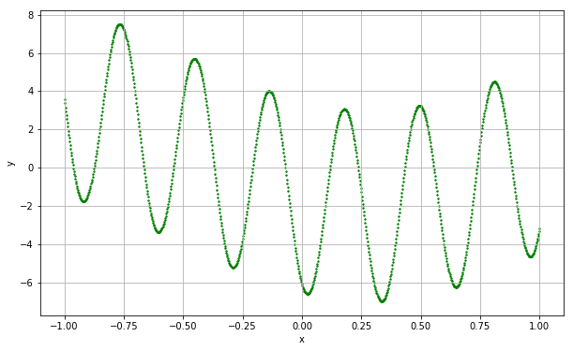
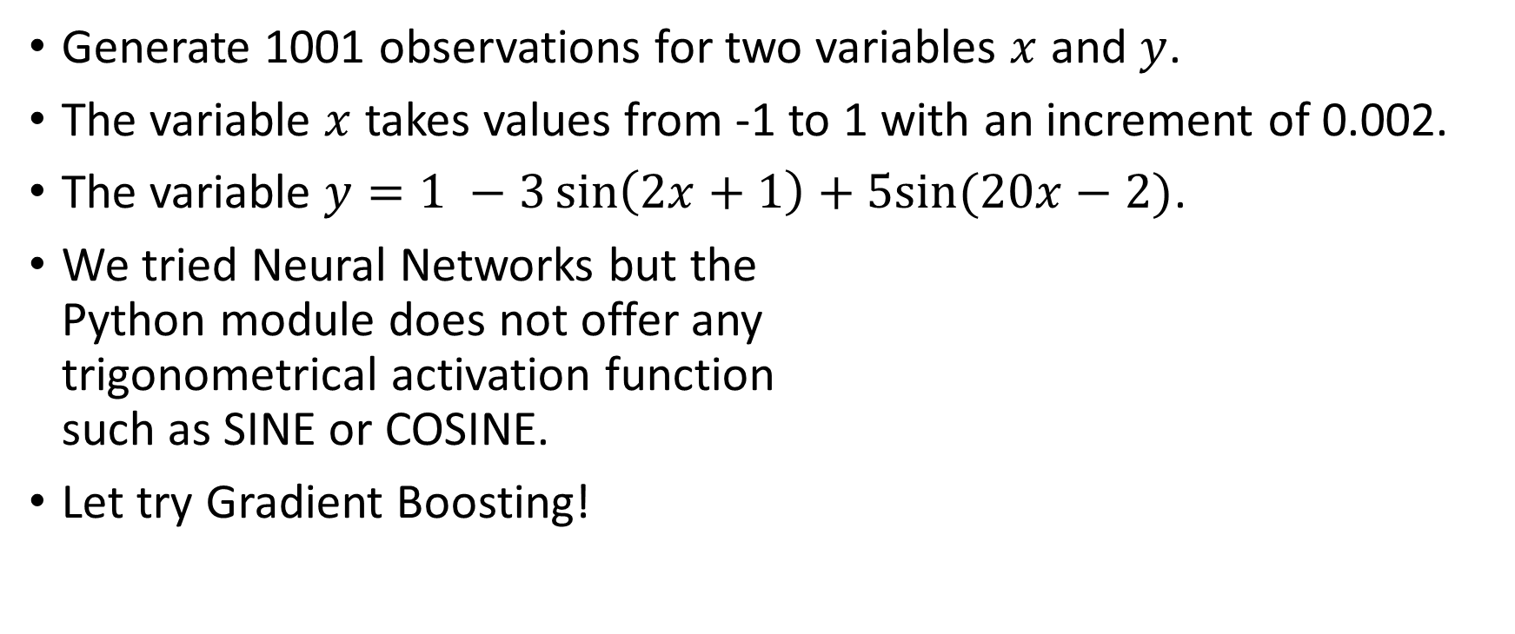
Composite Sine Data Example
Generate 1001 observations for two variables $x$ and $y$.
The variable $x$ takes values from -1 to 1 with an increment of 0.002.
The variable $y=1 −3\sin\left(2x+1\right)+5sin⁡(20x−2)$.
We tried Neural Networks but the Python module does not offer any trigonometrical activation function such as SINE or COSINE.
Let try Gradient Boosting!

Slide 46
Composite Sine Data Example
Gradient Boosting Regressor specifications
The loss function (L) is the Least Squares
The number of boosting step (M) is 1, 5, 10, 20, 40, 80, 100, 500, and 1000
The tree splitting criterion is the Mean Squared Error
The maximum number of tree terminal nodes is 14
Use the R-squared statistic to measure the goodness-of-fit between the observed and the predicted target values.
Week 14 Gradient Boosting Sine Curve.py

Slide 47
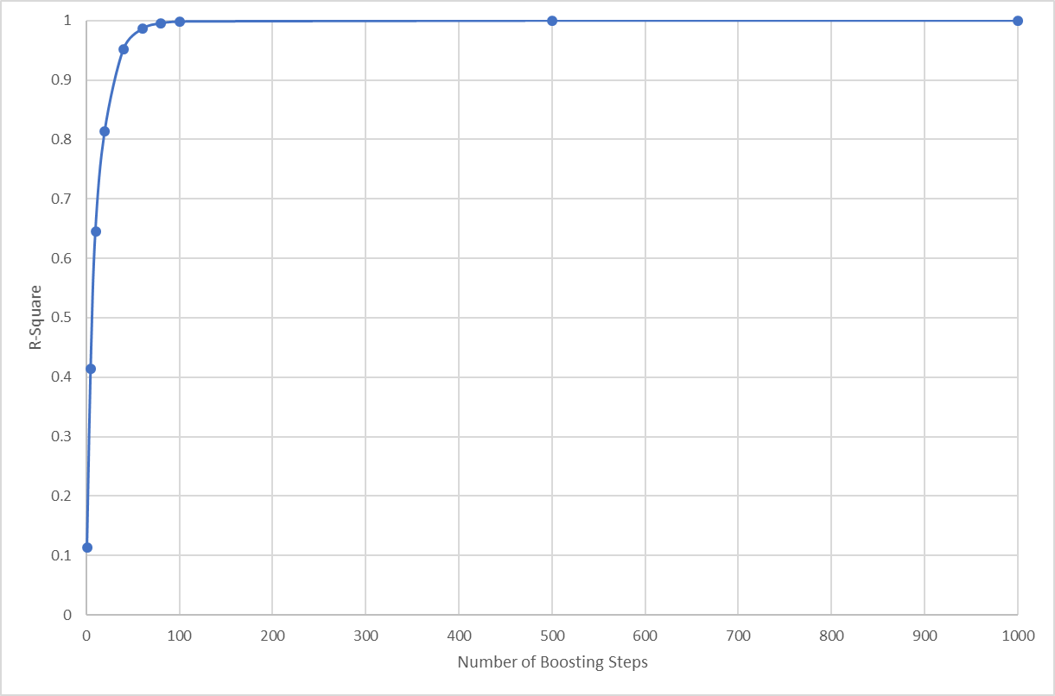
Composite Sine Data Example
Number of Boosting Steps (M) | R-Square Statistic
1 | 0.11354091
5 | 0.41408476
10 | 0.64476808
20 | 0.81391791
40 | 0.95127976
60 | 0.98595782
80 | 0.99553327
100 | 0.99833336
500 | 0.99995400
1000 | 0.99999360
Linear Regression Reference:
R-Square = 0.09396008
Intercept = -0.35467673
Slope = -2.00820904

Slide 48
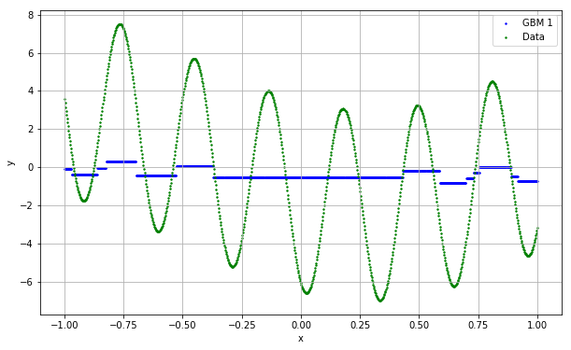
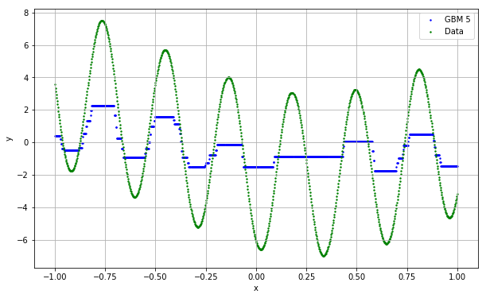
Composite Sine Data Example
Already picked up some cyclic patterns!

Slide 49
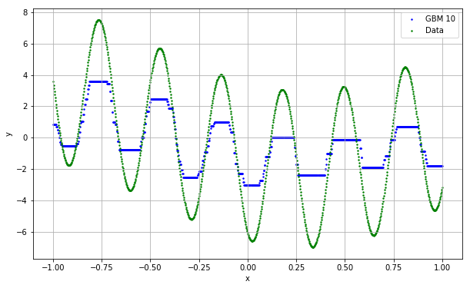
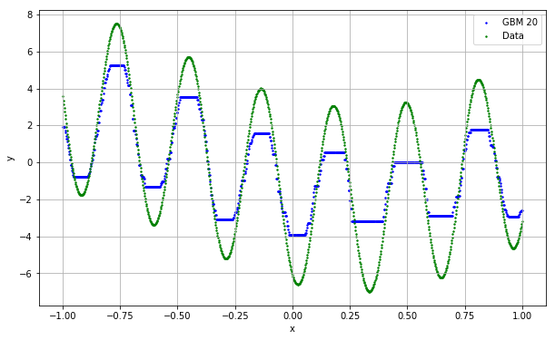
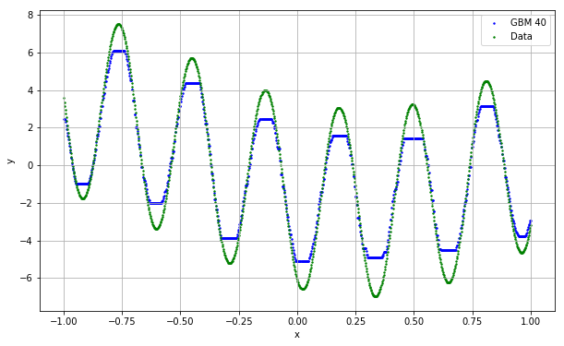
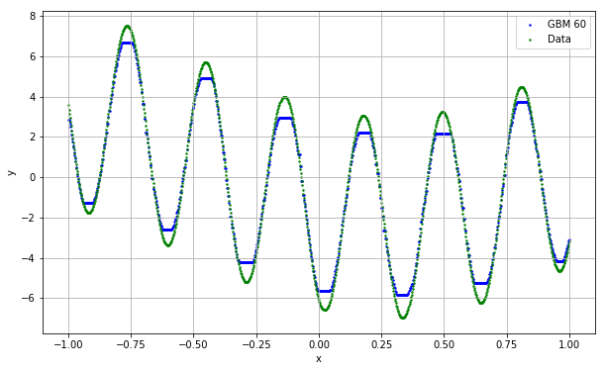
Composite Sine Data Example

Slide 50
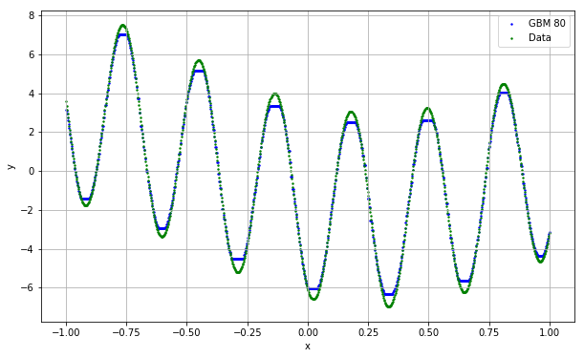
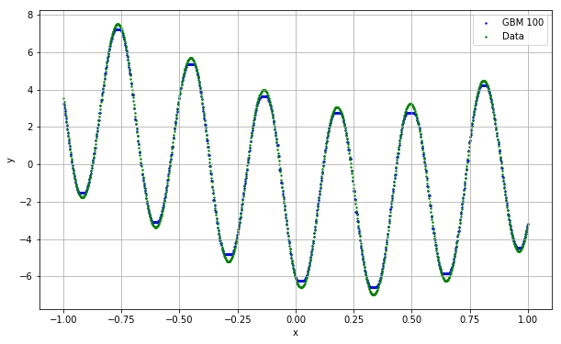
Composite Sine Data Example

Slide 51
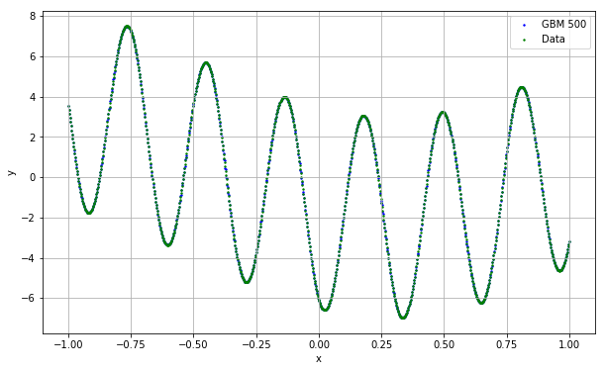
Composite Sine Data Example
Iter Train Loss Remaining Time
1 13.1202 4.28s
2 12.1790 2.52s
3 11.2638 1.92s
4 10.5523 1.57s
5 9.8525 1.35s
6 9.1511 1.20s
7 8.6589 1.10s
8 8.1127 1.02s
9 7.6571 0.96s
10 7.1302 0.89s
20 4.5317 0.54s
30 2.8099 0.41s
40 1.9146 0.34s
50 1.3721 0.29s
60 0.8661 0.26s
70 0.6172 0.23s
80 0.4257 0.21s
90 0.3011 0.20s
100 0.2164 0.18s
200 0.0121 0.10s
300 0.0051 0.06s
400 0.0036 0.03s
500 0.0026 0.00s

Slide 52
Wine Quality Classification Example
quality_grp | Frequency | Percent
0 | 5,220 | 80.3%
1 | 1,277 | 19.7%
There are 6,497 observations.
The binary target variable is quality_grp
Consider these seven interval predictors:
fixed_acidity
citric_acid
residual_sugar
free_sulfur_dioxide
total_sulfur_dioxide
pH
sulphates
We intentionally hold back the four most predictive variables: volatile_acidity, chlorides, density, and alcohol
Week 14 Gradient Boosting Wine.py

Slide 53
Wine Quality Classification Example
A Binary Logistic model
The Confusion Matrix is
The accuracy rate is 80.28%
Model | Parameter Estimate
const | 0.480926
fixed_acidity | -0.253305
citric_acid | 1.970866
residual_sugar | -0.030953
free_sulfur_dioxide | 0.015142
total_sulfur_dioxide | -0.007365
pH | -0.139795
sulphates | 0.503669
 | Predicted Class
quality_grp | 0 | 1
0 | 5,214 | 6
1 | 1,275 | 2
Week 14 Gradient Boosting Wine.py

Slide 54
Wine Quality Classification Example
Gradient Boosting Regressor specifications
The loss function (L) is the Deviance (i.e., the log-likelihood)
The number of boosting step (M) is 1, 5, 10, 20, 40, 80, 100, 500, and 1000
The tree splitting criterion is the Mean Squared Error
The maximum number of tree terminal nodes is 10
Use the Accuracy statistic to measure the goodness-of-fit between the observed and the predicted target values.
X = WineQuality[X_name]
gbm = ensemble.GradientBoostingClassifier(loss='deviance', criterion='mse', n_estimators = 1000,
max_leaf_nodes = 10, verbose=1)
fit_gbm = gbm.fit(X, y)
predY_gbm = gbm.predict(X)
Accuracy_gbm = gbm.score(X, y)
print('Gradient Boosting Model:', 'Accuracy = ', Accuracy_gbm)

Slide 55
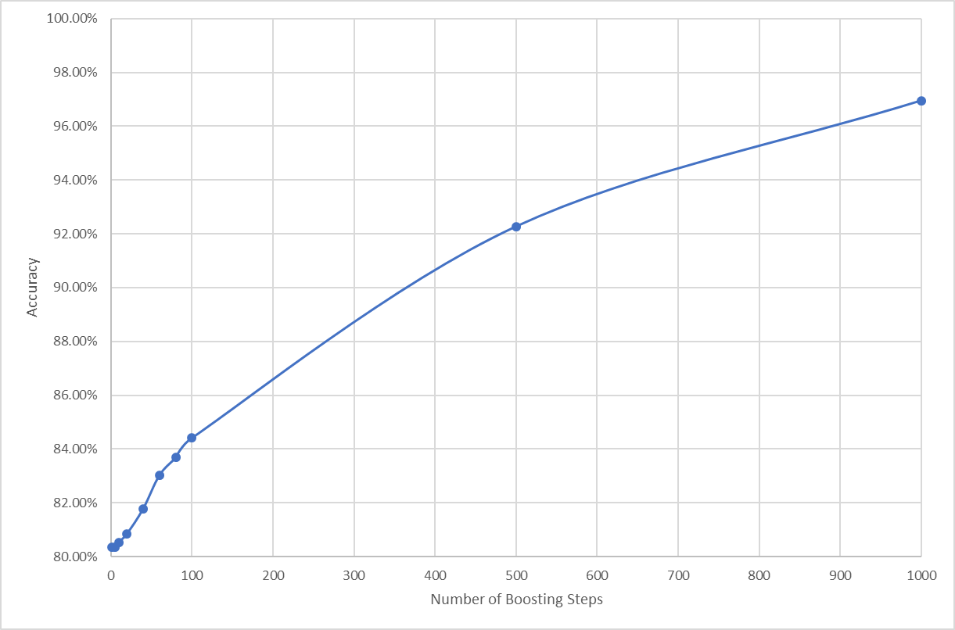
Wine Quality Classification Example
Number of Boosting Steps (M) | Accuracy Statistic
1 | 80.34%
5 | 80.34%
10 | 80.54%
20 | 80.85%
40 | 81.78%
60 | 83.02%
80 | 83.68%
100 | 84.41%
500 | 92.27%
1000 | 96.95%
Logistic Regression Reference:
Accuracy = 80.28%

Slide 56
Wine Quality Classification Confusion Matrix
Logistic Regression | Predicted Class
quality_grp | 0 | 1
0 | 5,214 | 6
1 | 1,275 | 2
GBM 1 | Predicted Class
quality_grp | 0 | 1
0 | 5,220 | 0
1 | 1,277 | 0
GBM 5 | Predicted Class
quality_grp | 0 | 1
0 | 5,220 | 0
1 | 1,277 | 0
GBM 10 | Predicted Class
quality_grp | 0 | 1
0 | 5,220 | 0
1 | 1,264 | 13
GBM 20 | Predicted Class
quality_grp | 0 | 1
0 | 5,220 | 0
1 | 1,244 | 33
GBM 40 | Predicted Class
quality_grp | 0 | 1
0 | 5,200 | 20
1 | 1,164 | 113
GBM 60 | Predicted Class
quality_grp | 0 | 1
0 | 5,275 | 45
1 | 1,058 | 219
GBM 80 | Predicted Class
quality_grp | 0 | 1
0 | 5,161 | 59
1 | 1,001 | 276
GBM 100 | Predicted Class
quality_grp | 0 | 1
0 | 5,148 | 72
1 | 941 | 336

Slide 57
Wine Quality Classification Confusion Matrix
GBM 500 | Predicted Class
quality_grp | 0 | 1
0 | 5,161 | 59
1 | 443 | 834
More boosting steps will increase the accuracy rate
Can we achieve a 100% accuracy rate? Let’s try 2,500 boosting steps.
GBM 1000 | Predicted Class
quality_grp | 0 | 1
0 | 5,200 | 20
1 | 178 | 1,099
GBM 2500 | Predicted Class
quality_grp | 0 | 1
0 | 5,219 | 1
1 | 1 | 1,276

Slide 58
Gradient Boosting: Pros
Really easy to use and it runs fast
The algorithm works, in theory, with any base learners
Base learner inherits the favorable merits of regression tree
Robustness against outliers and extreme values
Unnecessary to transform input variables
A built-in mechanism to select input variables
Ability to handle missing values in input variables (depends on implementation)
Avoids the often confusing choices of convergence criteria (because, it basically have none, except the number of boosting steps)
It does not rely on the original learning algorithm to gain improvement

Slide 59
Gradient Boosting: Cons
Challenges in deployment
Produced many base learners like most Bagging and the AdaBoost algorithm
Base learner inherits the unfavorable merits of regression tree
Inaccuracy due to not enough terminal nodes for smaller trees
Special attention is needed to ensure all base learners return valid scores
Instability due to overfitting for larger trees
Often competing choices of specifying a tree, e.g., maximum number of nodes, maximum number of depths, minimum observations in a node, etc.

Slide 60
XGBoost: eXtreme Gradient Boosting
According to https://github.com/dmlc/xgboost
XGBoost is an optimized distributed gradient boosting library designed to be highly efficient, flexible and portable.
XGBoost implements machine learning algorithms under the Gradient Boosting framework.
XGBoost provides a parallel tree boosting that solve many data science problems in a fast and accurate way.

Slide 61
XGBoost: eXtreme Gradient Boosting
Chen, Tianqi and Guestrin, Carlos (2016). XGBoost: A Scalable Tree Boosting System, Proceedings of the 22nd ACM SIGKDD Conference on Knowledge Discovery and Data Mining, 2016, San Francisco. pp. 785-794. https://dl.acm.org/citation.cfm?id=2939785
Chen, Tianqi
Guestrin, Carlos
Amazon Professorship in Machine Learning , Paul G. Allen School of Computer Science & Engineering, University of Washington
https://www.cs.washington.edu/people/faculty/guestrin/
Assistant Professor, Carnegie Mellon University
https://tqchen.com/
OctoML

Slide 62
XGBoost: eXtreme Gradient Boosting
Project website: https://pypi.org/project/xgboost/
Installation via Wheel file: https://pypi.org/project/xgboost/#files
The current version is 1.2.1 released on October 13, 2020
pip install xgboost-1.2.1-py3-none-win_amd64.whl for Windows

Slide 63
Composite Sine Data Example
Extreme Gradient Boosting Regressor specifications
The number of boosting step (M) is 1, 5, 10, 20, 40, 80, 100, 500, and 1000
The tree maximum depth is 3
The random state value is 60616
Use the R-squared statistic to measure the goodness-of-fit between the observed and the predicted target values.
Week 14 XGBoosting Sine Curve.py

Slide 64
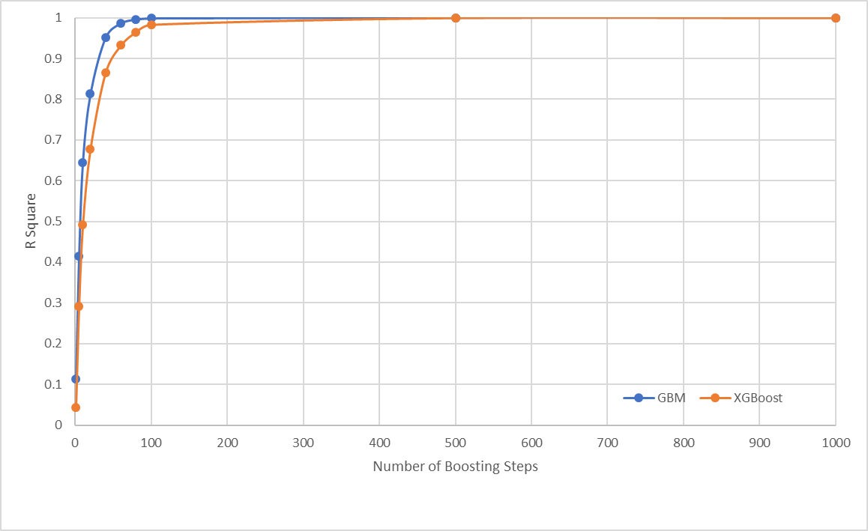
Composite Sine Data Example
Number of XGBoosting Steps | R-Square Statistic
1 | 0.04252874
5 | 0.29202585
10 | 0.49145709
20 | 0.67836862
40 | 0.86551065
60 | 0.93214265
80 | 0.96489772
100 | 0.98313266
500 | 0.99977819
1000 | 0.99990370
Linear Regression Reference:
R-Square = 0.09396008
Intercept = -0.35467673
Slope = -2.00820904

Slide 65
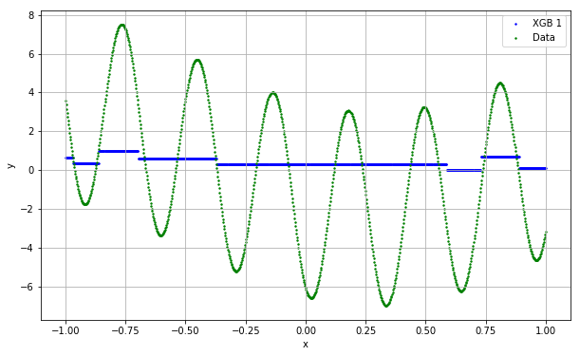
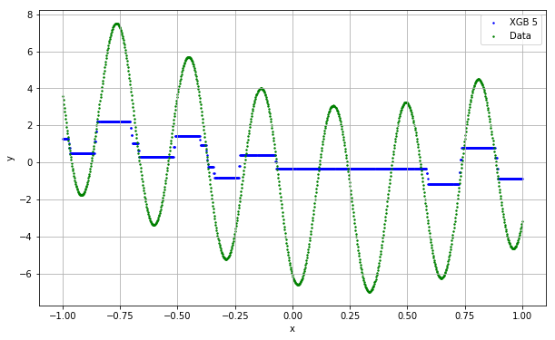
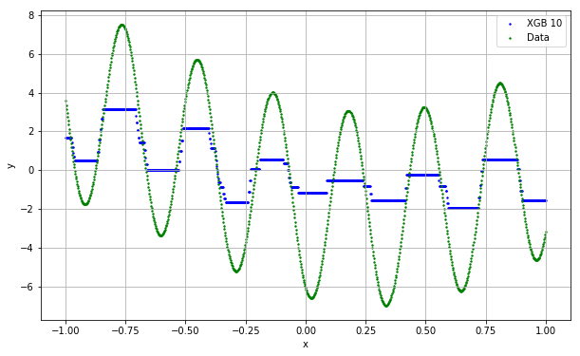
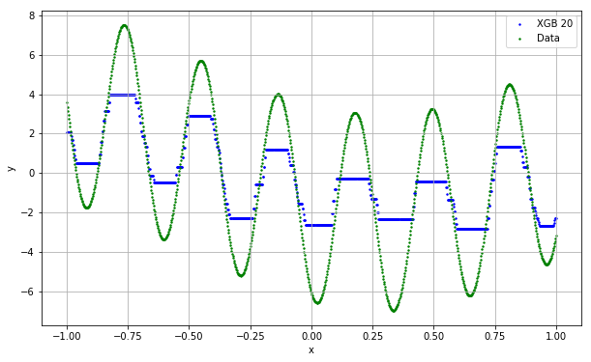


Composite Sine Data Example

Slide 66




Composite Sine Data Example

Slide 67
Model Stacking: Overview
Model stacking is a meta-ensemble method. It contains two levels.
In the first level, several models are built by using different learning algorithms (e.g., logistic regression, naïve Bayes, neural networks, and support vector machines).
Each model generates its predictions (whether predicted probabilities or predicted class)
In the second level, the compatible predictions are combined optimally by yet another model.

Slide 68
Model Stacking: Second Level
Interval Target Variable
The predicted values from the first level models are inputs to a regression model.
The original target values are the dependent values of that regression.
Categorial Target Variable
The predicted values from the first level models are inputs to a logistic regression model.
The original target categories are the dependent values of that logistic regression.

Slide 69
Model Stacking: References
Joseph Sill, Gabor Takacs, Lester Mackey, and David Lin (2009). https://www.researchgate.net/publication/45882061_Feature-Weighted_Linear_Stacking
Funda Gunes, Russ Wolfinger, and Pei-Yi Tan (2017). Stacked Ensemble Models for Improved Prediction Accuracy, Proceedings of the SAS Global Forum 2017, Orlando, Florida. https://support.sas.com/resources/papers/proceedings17/SAS0437-2017.pdf
The Python mlxtend module. (We used mlxtend for Association Rule) http://rasbt.github.io/mlxtend/user_guide/classifier/StackingClassifier/

Slide 70
Final Examination
Count 25% toward your final course grade
Online, open-book, open-note format
Available at 12:01 AM Chicago time on Thursday December 3, 2020
Due at 11:59 PM Chicago time on Wednesday December 9, 2020
Late submission penalty is 2 points per hour past due

Slide 71
Thank You for Attending the Machine Learning Class!
Contact Information mlam5@iit.edu ming-long.lam@sas.com

